Slide 1
AI in the performing arts, Film Studies and Marketing education
Ina Stanoeva
Varna University of Management
Theatre Foundation “L. Groys”

Slide 2
aI in the arts - Music
Heart on my sleeve – Weekend ft Drake -https://www.youtube.com/watch?v=pIJSKxVJppA

Slide 3
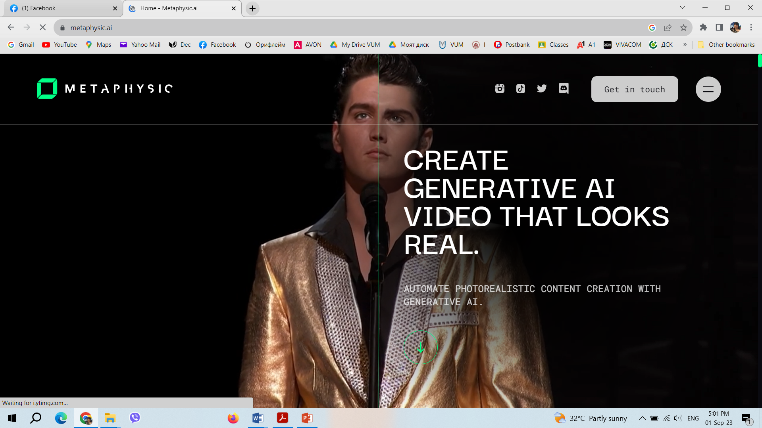
Ai in the arts – face swap
Metaphysic.ai

Slide 4
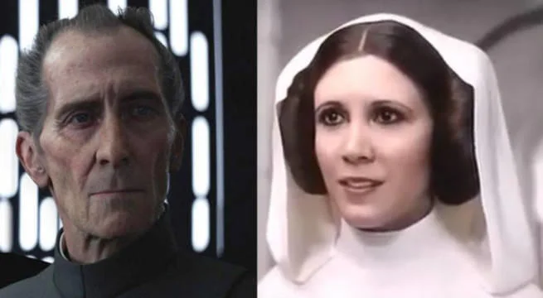
Ai in the arts - movies
A computer-generated versions of actors Carrie Fisher and Peter Cushing have been featured in a movie named 'Star Wars: The Rise of Skywalker' from the 'Star wars'

Slide 5
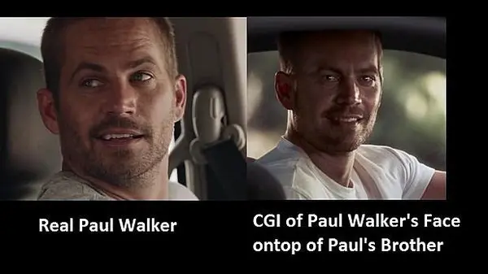
Ai in the arts - movies
Weta Digital to continue the movie “Fast and furious” 7 after Paul Walker’s death.

Slide 6
Ai in the arts
https://app.colossyan.com/
Botnik uses AI algorithm to mix texts of existing books to create a new chapter.
ScriptBook is used for writing scripts for movies and books.
Benjamin, which is an AI software, created the script of a fictional short film, Sunspring (2016).
Its sequel No Game from 2017 was a combination between its efforts and humans.
Other famous movie examples are the 6-minute movie trailer of the horour movie “Morgan” and Benjmin’s “Zone out” which was created for only 48 hours. The last was developed with face-swapping, based on a GAN and voice-generating technologies. It is also one of the first directed only by AI. (Anantrasirichai & Bull, 2022).

Slide 7
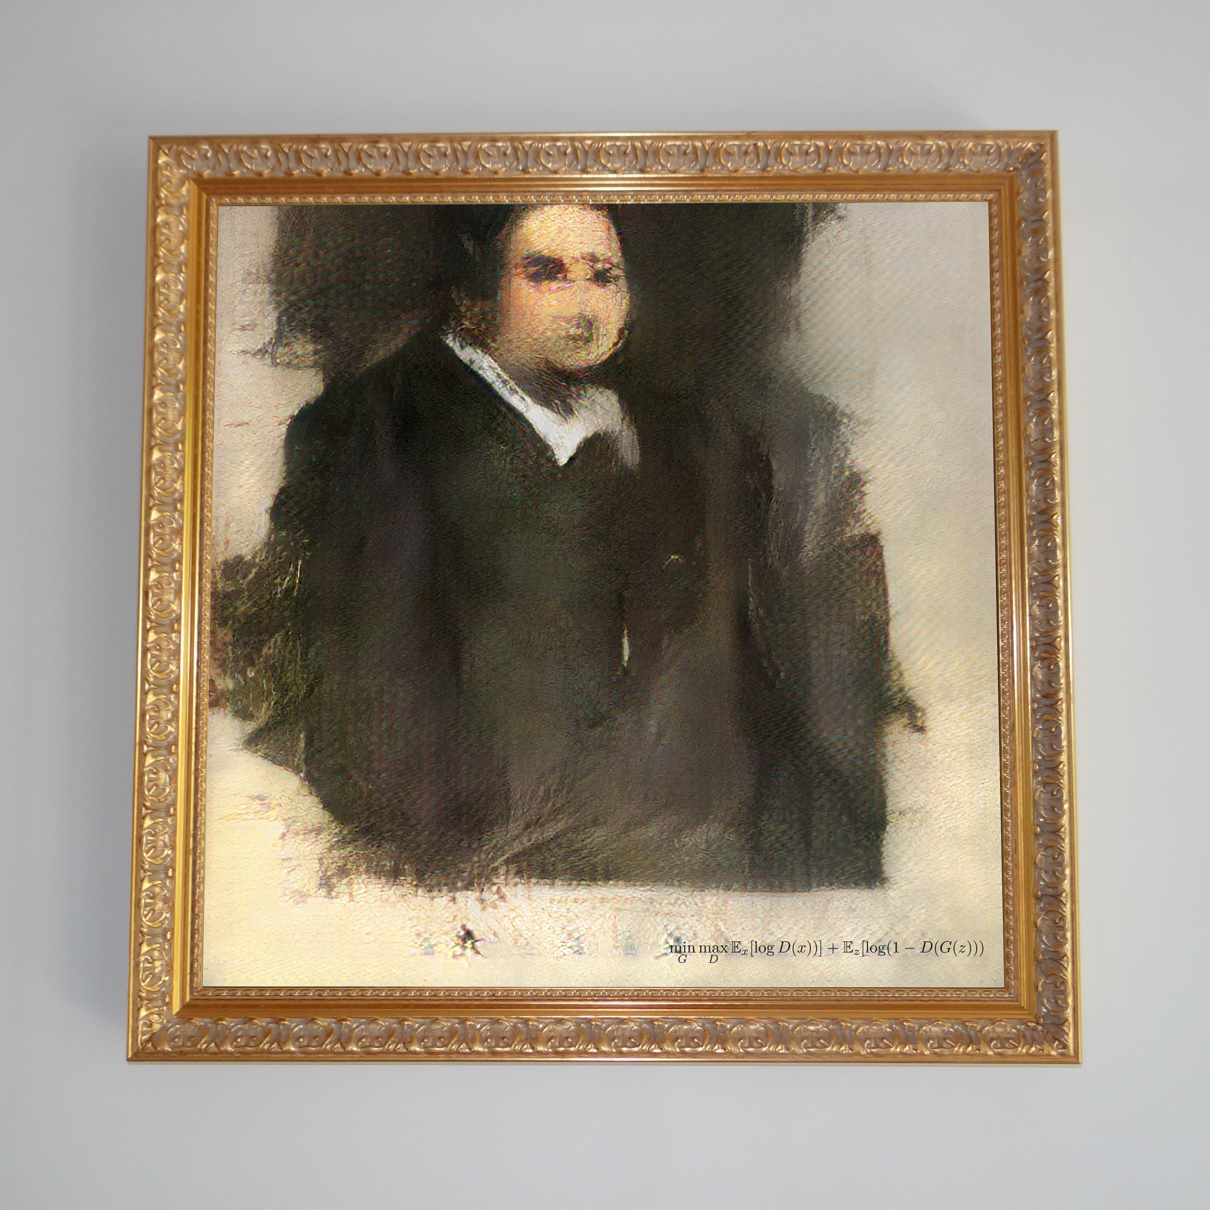
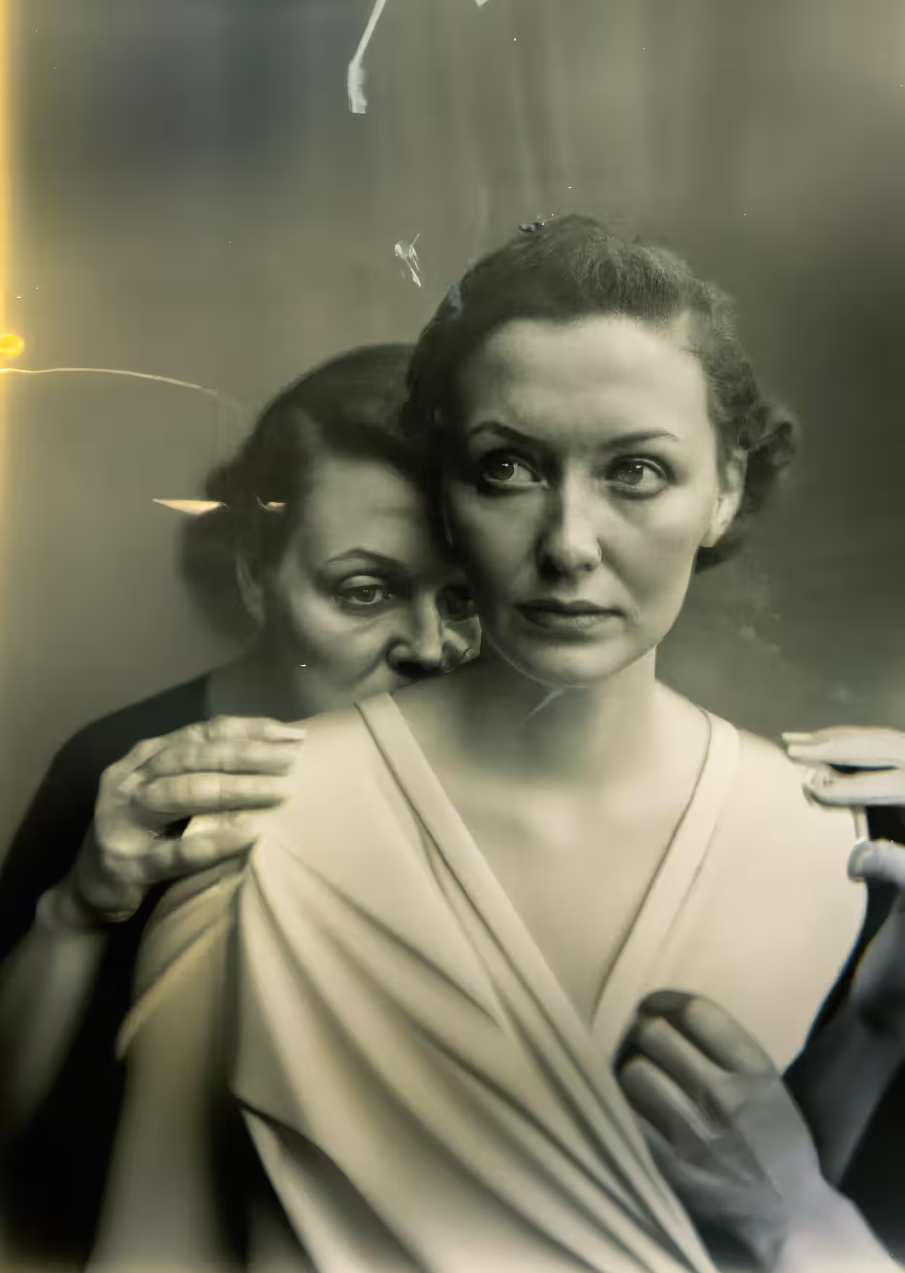
Ai in the visual arts
One of the most famous painting is Edmond de Belamy. This is a painting created in 2018 by french collective Obvious, using a type of Artificial Intelligence algorithms or the so called Generative Adversarial Networks. The painting is sold at Christie's auction house in New York for $ 432,500 (Goenaga, 2020).
There are also known attempts to create Sketch drawings using AI possibilities (Cao, Yan, Shi, Chen, & Aaai, 2019).
Moreover, there are many websites that gives the possibility to the the general public to create generative AI paintings, photographs and pictures such as openart.ai, fotor, dall e 2, hotpot.ai, night café, Dep aI,dep dream generator, craiyon,starry ai. (Fotor, 2023).
On April 2023 the photographer Boris Eldagsen wins a competition organized by Sony with AI generated photography. His idea was to show that AI generated photographs can not be distinguished from real ones made by humans. This caused major concerns in the photography world about the ethical issues of such usage. (Guardian, 2023).
Also, AI has been extensively used in the gaming creation industry

Slide 8
In Marketing communications classes

Slide 9
For a Campaign in the performing arts
Facebook posts
Video script
Press release
Marketing strategy
Poster creation

Slide 10
Methodology
For the purposes of this article, we use the observation method, comparative analysis, experiment and the case study presentation method. We use a real theatre performance (a monologue) by the actress Silviya Stanoeva. It was presented on 21st January 2023 at the Theater Argot In Rome.
A real marketing expert created a poster, a Facebook campaign, a video for the performance as a trailer and organized a radio campaign with interviews with the actress.
On 1st of September we used ChatGPT to replicate the marketing activities used by the real marketer and Fotor, Wepik, Kittl, Appypie and designs.ai to recreate the poster with the requirements of the client – the actress.

Slide 11
CHATGPT
Prompt: Act as a professional marketing manager with years of experience. Write three different Facebook ads to promote my event. The details of the event are as follows: Title: Diary of The War, Monologo in Bulgaro di Silviya Stanoeva Place: Teatro Argot, Rome via Natale del Grande 27 at 20 h on 21.01.2023

Slide 12
Ad 1: Event Announcement
Image: Eye-catching image of Silviya Stanoeva performing on stage
Text: 🎭 Join us for a captivating evening of theater! 📅 Date: January 21, 2023 🕗 Time: 20:00 📍 Venue: Teatro Argot, Rome 🎟️ Get your tickets now!
Description: Experience the mesmerizing performance of "Diary of The War" by Silviya Stanoeva in Bulgarian at the renowned Teatro Argot in Rome. Secure your seats for an unforgettable night of theater!

Slide 13
Ad 2: Silviya Stanoeva Spotlight
Image: A stunning portrait of Silviya Stanoeva
Text: 🌟 Witness the brilliance of Silviya Stanoeva! 📅 Date: January 21, 2023 🕗 Time: 20:00 📍 Venue: Teatro Argot, Rome 🎭 "Diary of The War" - A monologue in Bulgarian
Description: Don't miss the chance to witness the incredible talent of Silviya Stanoeva as she performs "Diary of The War" in Bulgarian. An evening filled with emotion and artistry awaits you at Teatro Argot in Rome!

Slide 14
Ad 3: Limited Seats Available
Image: Teatro Argot illuminated at night
Text: 🚨 Limited Seats Available! 🚨 📅 Date: January 21, 2023 🕗 Time: 20:00 📍 Venue: Teatro Argot, Rome 🎭 "Diary of The War" - Monologo in Bulgaro
Description: Hurry, seats are filling up fast for "Diary of The War" by Silviya Stanoeva. Reserve your spot at Teatro Argot in Rome and immerse yourself in a powerful and moving performance. Don't wait, book now!
These ads highlight key event details, showcase the performer, and create a sense of urgency to encourage potential attendees to secure their tickets. Make sure to replace placeholders with the actual event image and ensure the visuals and messaging align with the event's theme and the audience you want to target on Facebook.

Slide 15
Real campaign – Facebook post

Slide 16
Press release for the media
FOR IMMEDIATE RELEASE
Captivating Theater Event "Diary of The War" Comes to Rome: Silviya Stanoeva's Monologue in Bulgarian
Rome, [Date] — The enchanting city of Rome is set to host a remarkable theatrical experience on January 21, 2023, as the renowned Teatro Argot proudly presents "Diary of The War," a powerful monologue performed by the exceptionally talented Silviya Stanoeva.
Event Details:
Title: Diary of The War, Monologo in Bulgaro di Silviya Stanoeva
Date: January 21, 2023
Time: 20:00
Venue: Teatro Argot, via Natale del Grande 27, Rome
"Diary of The War" is a gripping and emotionally charged performance that promises to transport the audience into a world of raw human experiences and profound storytelling. Silviya Stanoeva, a luminary in the world of theater, takes center stage to deliver a monologue in Bulgarian that has garnered acclaim for its depth and intensity.
The event is set to take place at the iconic Teatro Argot, known for hosting exceptional performances and creating memorable theatrical moments. With its intimate setting and state-of-the-art facilities, Teatro Argot provides the perfect backdrop for an evening of artistic brilliance.
This exceptional theatrical event is a testament to the enduring power of the arts to connect, inspire, and provoke thought. "Diary of The War" is a reflection on the human condition, war, and the resilience of the human spirit, making it a must-see for theater enthusiasts and those seeking a thought-provoking cultural experience.
Tickets for "Diary of The War" are available now, and with limited seating, it's advisable to secure your spot early. Tickets can be purchased through the official Teatro Argot website, or at the theater's box office.
This event promises to be a highlight of the cultural calendar in Rome, and media coverage is encouraged to capture the essence of this extraordinary evening.
For media inquiries, press passes, or interviews with Silviya Stanoeva, please contact:
[Your Name] [Your Title] [Your Contact Information]
About Teatro Argot: Teatro Argot is a revered cultural institution in Rome, dedicated to bringing world-class theater to its audience. With a history of hosting exceptional performances, it continues to be a hub for artistic expression and cultural enrichment.
About Silviya Stanoeva: Silviya Stanoeva is a highly acclaimed actress known for her exceptional talent and compelling performances. Her portrayal of "Diary of The War" has received critical acclaim and touched the hearts of audiences worldwide.
For more information about the event, please visit [event website link].
Follow us on social media: [Social media links]

Slide 17
A script for 1-minute video in YOuTube
[Opening shot: A captivating view of Teatro Argot's marquee sign illuminated against the night sky]
Narrator (Voiceover): "Get ready for an unforgettable night of theater in the heart of Rome!"
[Cut to shots of Teatro Argot's exterior and interior, showcasing its charm and ambiance]
Narrator (Voiceover): "On January 21, 2023, at 20:00, join us at the iconic Teatro Argot, located at via Natale del Grande 27."
[Transition to a spotlighted stage with a chair and a striking visual of Silviya Stanoeva]
Narrator (Voiceover): "Experience the mesmerizing performance of 'Diary of The War' by the incredibly talented Silviya Stanoeva."
[Clip of Silviya Stanoeva in a powerful monologue scene, conveying emotion and intensity]
Narrator (Voiceover): "This is more than just a play; it's an emotional journey, a reflection on humanity, war, and resilience."
[Quick montage of enthusiastic audience reactions and applause]
Narrator (Voiceover): "Join us for an evening of thought-provoking artistry and profound storytelling."
[Closing shot: Teatro Argot's marquee sign with event details]
Narrator (Voiceover): "Mark your calendars and secure your tickets now for 'Diary of The War, Monologo in Bulgaro di Silviya Stanoeva' at Teatro Argot, Rome."
[Text on screen: Event Date, Time, Venue, and Ticketing Information]
Narrator (Voiceover): "Don't miss this one-of-a-kind theatrical experience. Get your tickets today!"
[Text on screen: Event Website and Social Media Links]
Narrator (Voiceover): "Visit our website and follow us on social media for updates and exclusive behind-the-scenes content."
[Closing shot: A captivating image of Silviya Stanoeva in character, overlaid with event details]
Narrator (Voiceover): "Join us for 'Diary of The War.' Embrace the art. Feel the emotions. Experience the magic."
[End with the event's logo and ticket information]

Slide 18
Real campaign – youtube video
https://www.youtube.com/watch?v=5p492eXbDrY&t=12s

Slide 19
AI for marketing strategy
It suggested tactics for Facebook, Instagram, defining the target audience, Email Marketing, Influencer Marketing, Event Website, Online Communities, Flyers and Posters, Local Media, Cultural Organizations, Community Events, PR and Press Releases, Partnerships and Sponsors, sales promotions, event countdown and analytics.

Slide 20
AI for poster - Prompt
Create a poster with the actress Silvia Stanoeva, a mysterious man with a suit and the Eiffel tower

Slide 21
AI for poster - Fotor

Slide 22
AI poster - wepik

Slide 23
Real posters

Slide 24
Some conclusions
ChatGPT is a really good tool for writing posts, press releases and scripts. It can write and suggest a full marketing strategy for offline and online purposes, but it is too general and it lacks details and it can not be applied for every case.
The AI tools for creating images based on text are still not good enough to replace a graphic designer. They are also too general and lack creativity. They can not fulfill the customers requirements and look like taken stock phots from Internet. They can not use photos of famous people from Internet.
If these photos are used there is still legal and ethical implications on whose rights are they.
Still, AI can be used as a basic frame for experienced marketer, but they won’t be very useful for somebody without any prior marketing knowledge.

Slide 25
Future of AI in the cinema, theatre and education
Emotion
Creativity
Energy
Intuition

Slide 26
References
Link to ChatGPT: https://chat.openai.com/share/bd51e86f-6d29-4e64-a249-aa5e1bc58a52
https://platform.openai.com/docs/guides/images/language-specific-tips
https://app.kittl.com/
https://designcloud.appypie.com/editor
https://designs.ai/designmaker/start/search?category=5d503d6cf8ead94a97909b23&query=Poster
https://wepik.com/ai
https://chat.openai.com/share/bd51e86f-6d29-4e64-a249-aa5e1bc58a52

Slide 27
Thank you!
Ina Stanoeva
Assoc. Prof. PhD at
Varna University of Management
Ina.Stanoeva@vumk.eu
Ina12_bg@yahoo.com
Linkedin: Ina Stanoeva

