Slide 1
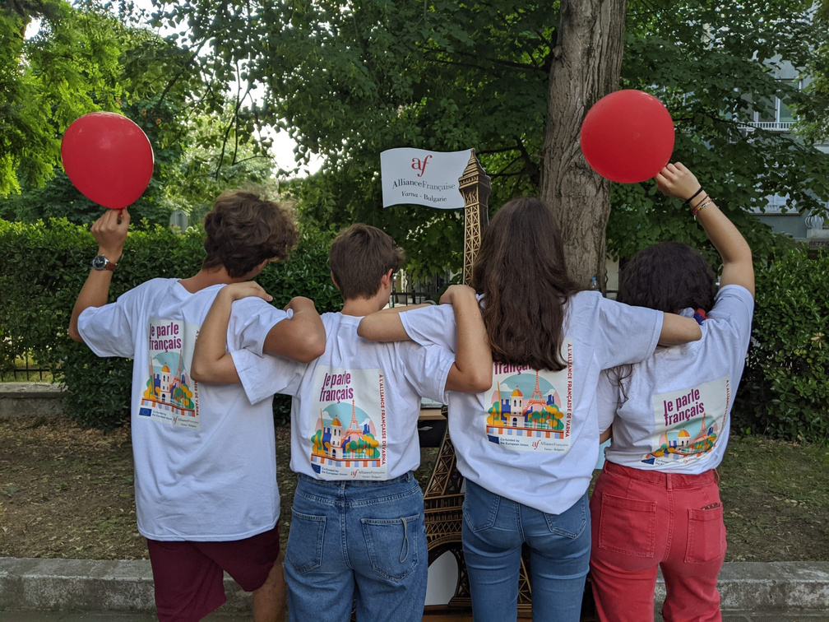


INTERNATIONAL EDUCATIONAL FORUM
VARNA URBAN SPACES –
AN OPEN STAGE FOR ALLIANCE FRANÇAISE VARNA’S ACTIVITIES
SHARING EXPERIENCES AND GOOD PRACTICES
MILENA NIKOLAEVA ANGELOVA,
ALLIANCE FRANÇAISE DE VARNA, BULGARIE, VARNA

Slide 2
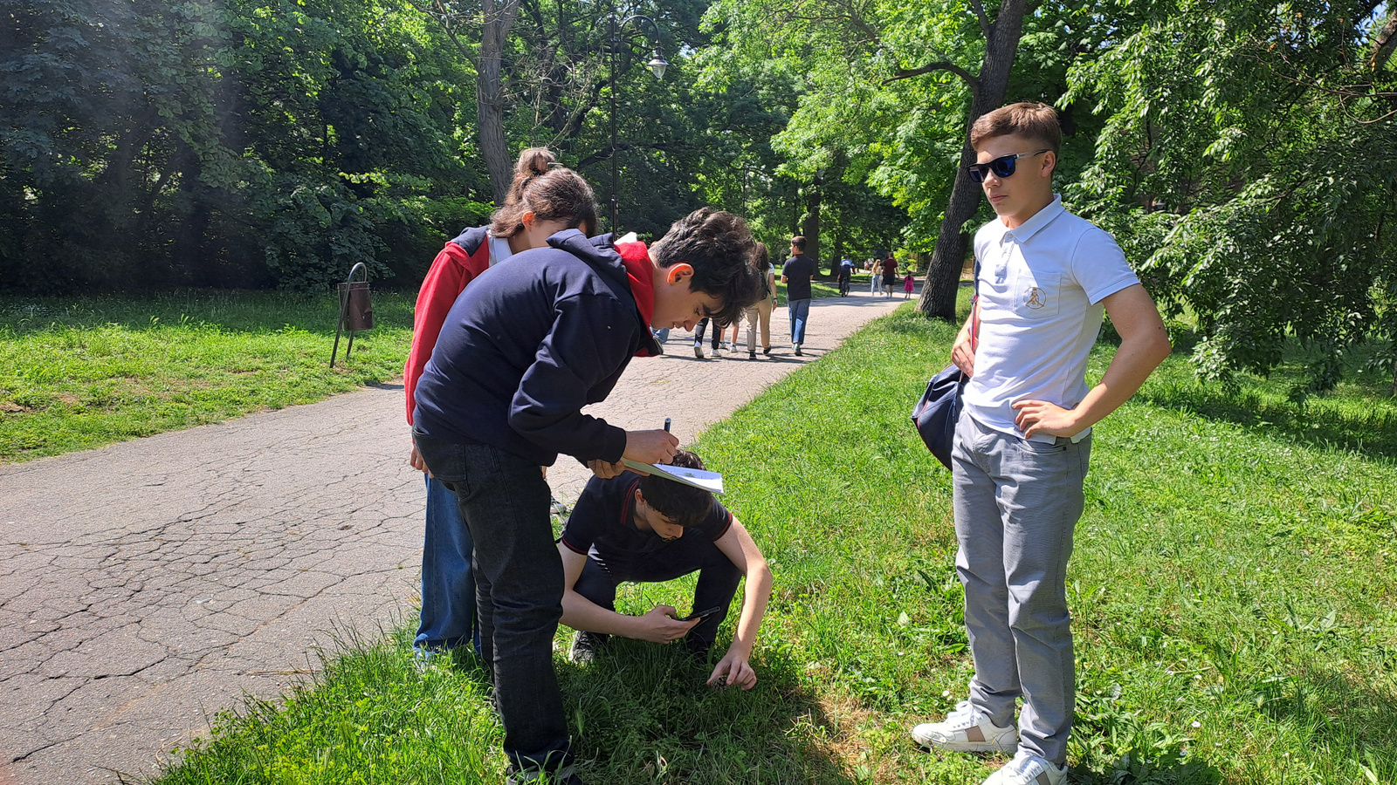
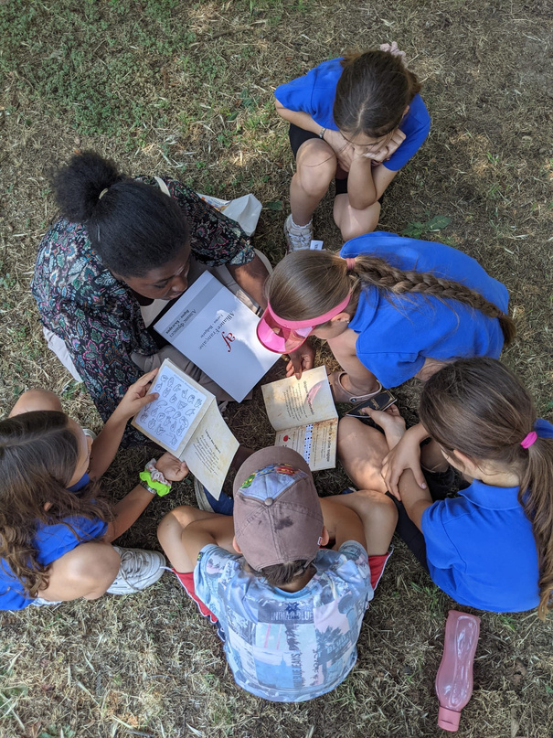
Activities with Varna's schoolchildren
Nature-themed treasure hunt in the Sea Garden
GAME-BASED METHODS
Using Varna's urban environment
as a learning tool for children
The Little Prince School (French-speaking class)
French International School
of Varna “Charles Perrault”

Slide 3
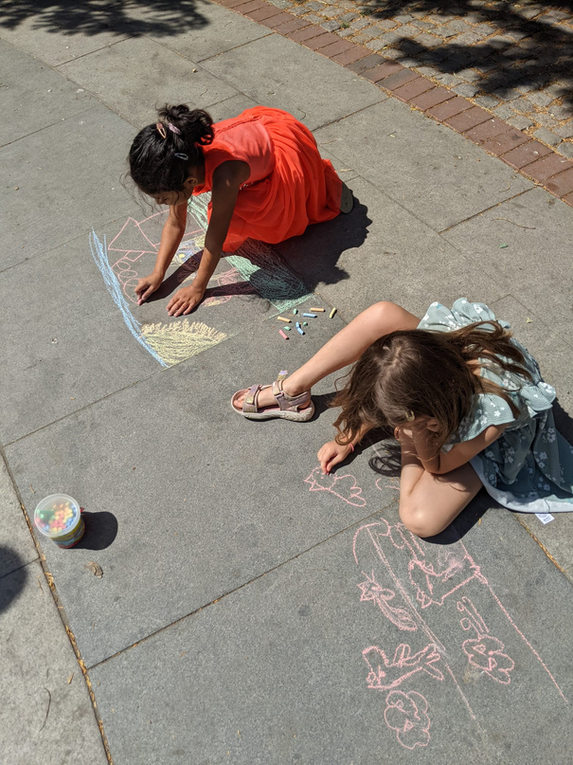
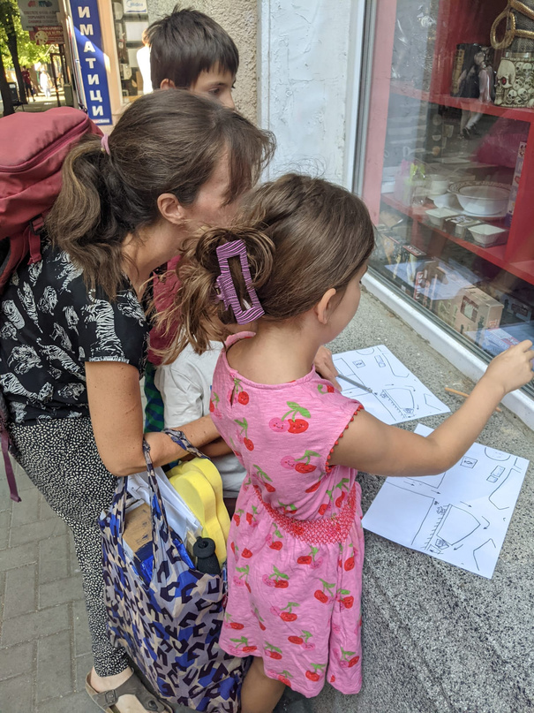
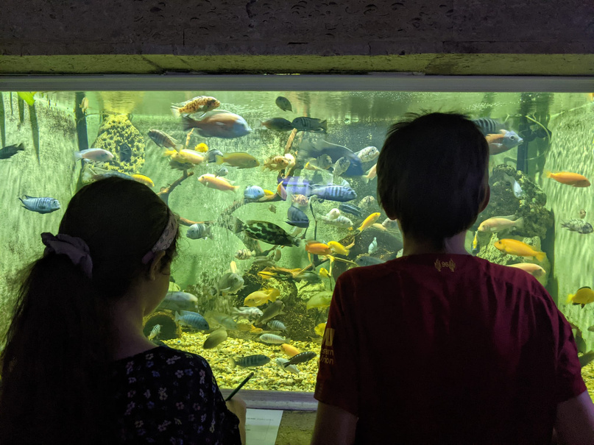
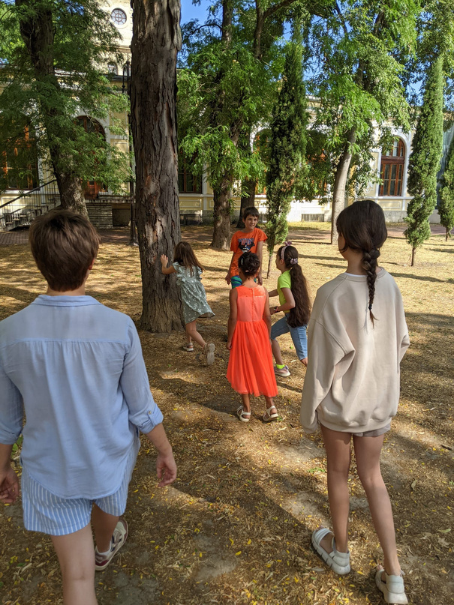
Activities within the summer camp
Day camp for French-learning children
Learning vocabulary related to professions on the streets of Varna
Games in the city’s parks
Discovery of the aquarium

Slide 4
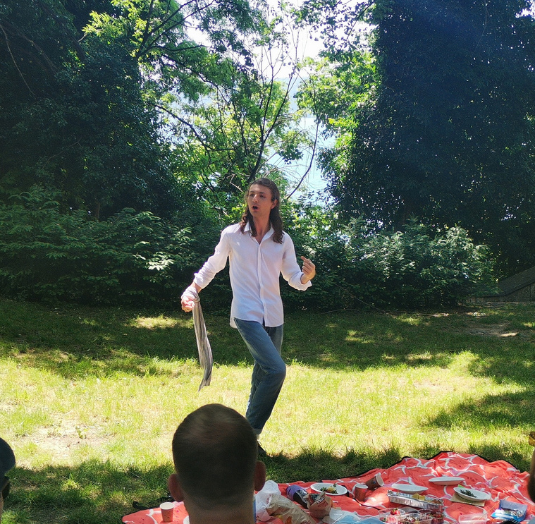
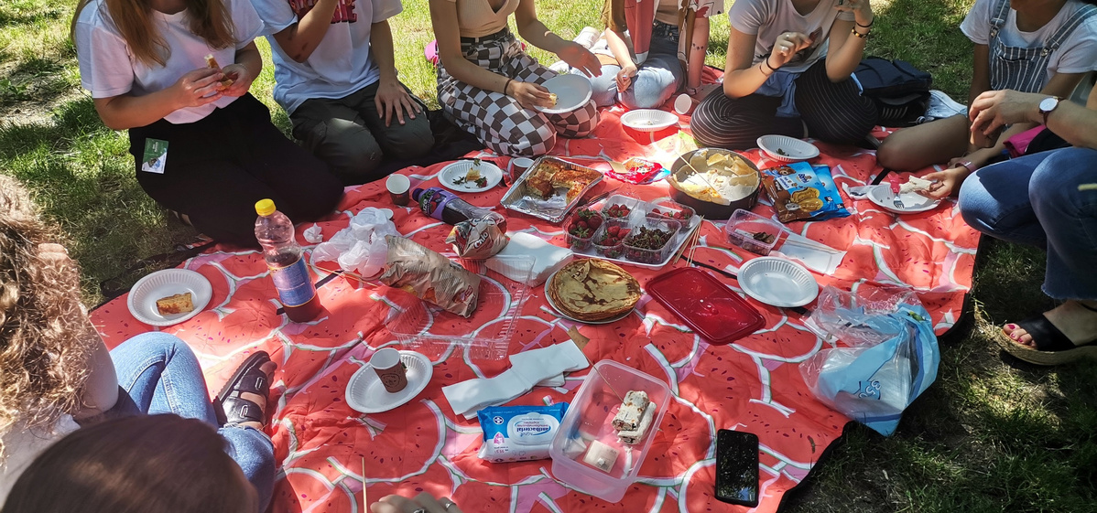
Eco picnic –
Vinitsa and Sea Garden
Cleansing of green spaces, theatrical performance, books exchange, picnic
OUTDOOR
ACTIVITIES
Activities related to French culture and the environment for members and the public of the association

Slide 5
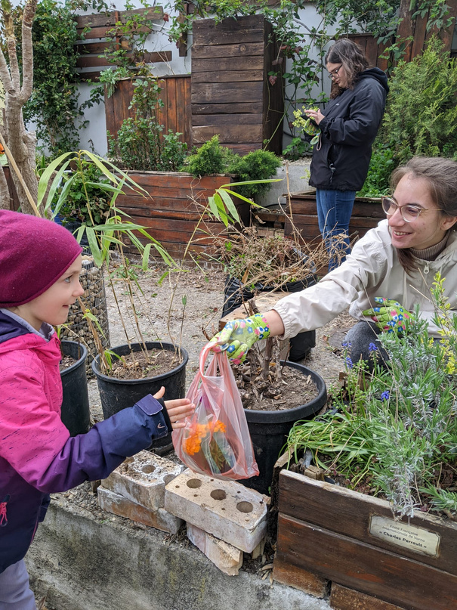
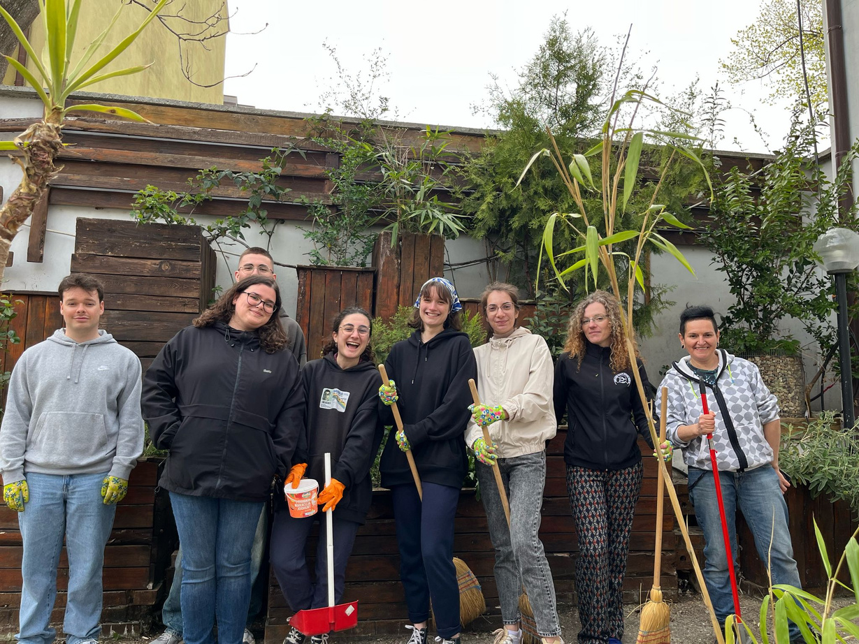

Ecoworkshop “gardening”
Maintenance of the Alliance Française Varna garden using
environmentally friendly solutions and with the help of the public

Slide 6
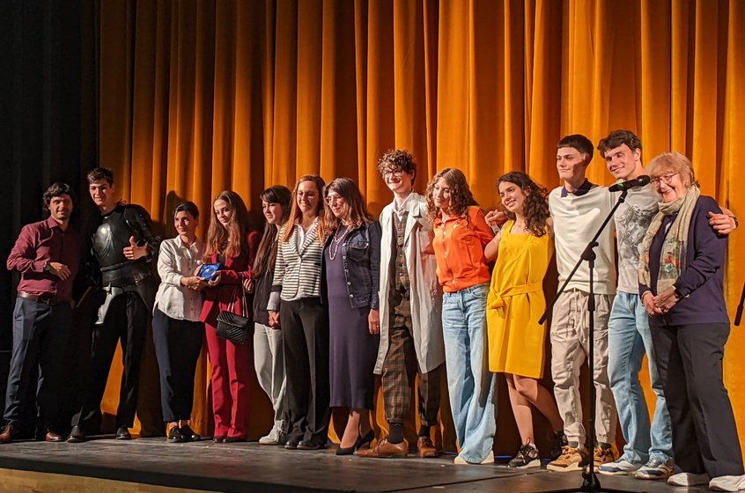
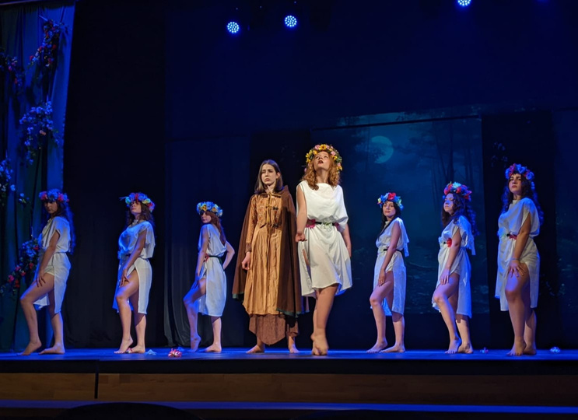
International Francophone
School Theater Festival
In partnership with the Varna Opera House, the French Ambassy in Bulgaria/ French Institute Bulgaria and the APFB (Association of French teachers in Bulgaria)
Performances in French presented by students from 8 French-teaching high schools
from Bulgaria and Romania
COOPERATION WITH
SCHOOLS, MUNICIPALITIES AND
CULTURAL INSTITUTIONS
... to create open educational spaces

Slide 7
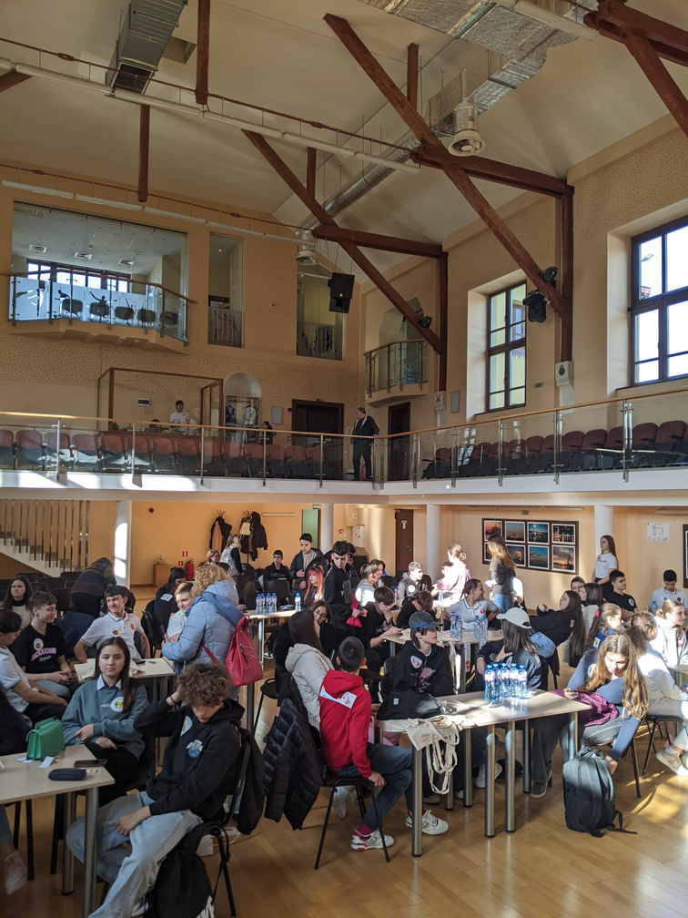
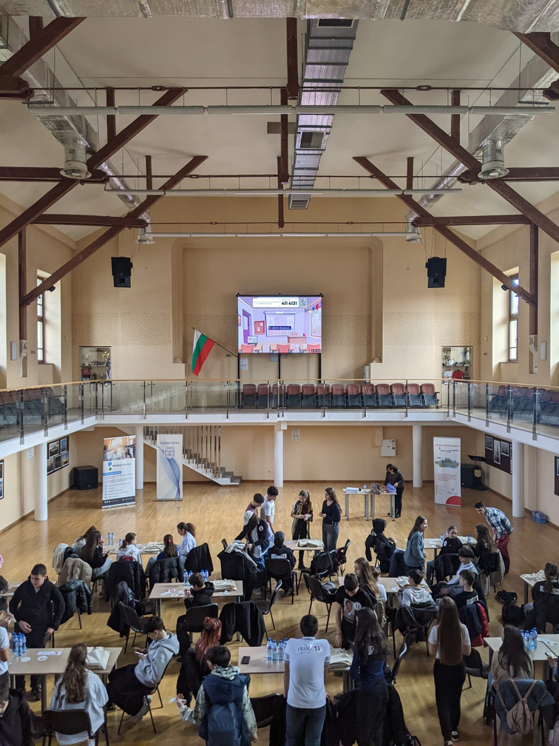
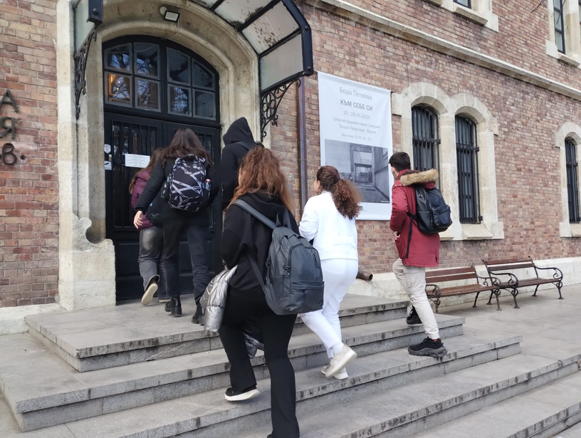
Francophone rally
In partnership with the municipality of Varna
Competition between students from the city's high schools teaching French through a tour of iconic locations in Varna (Youth House, Municipal Gallery, Planetarium) and a Kahoot quiz on the Francophonie at the Varna Sports Department Hall

Slide 8
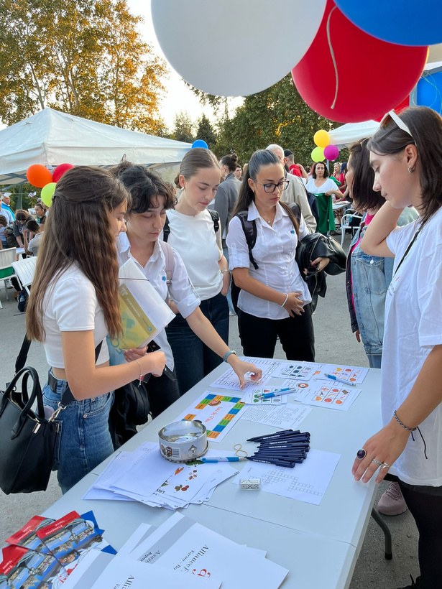
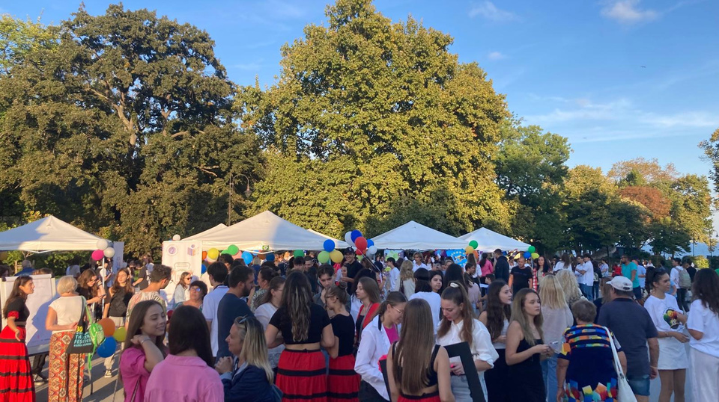
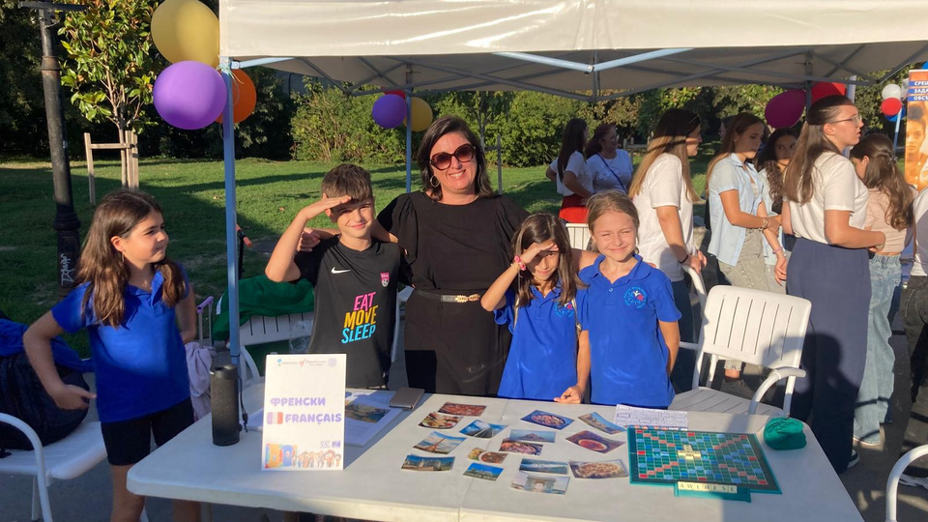
European Languages Day
In partnership with the municipality of Varna and in collaboration with the Regional Academy of Varna
Every year on September 26, celebration of linguistic diversity in Europe and promotion of
living language learning at the main entrance of the Sea Garden

Slide 9
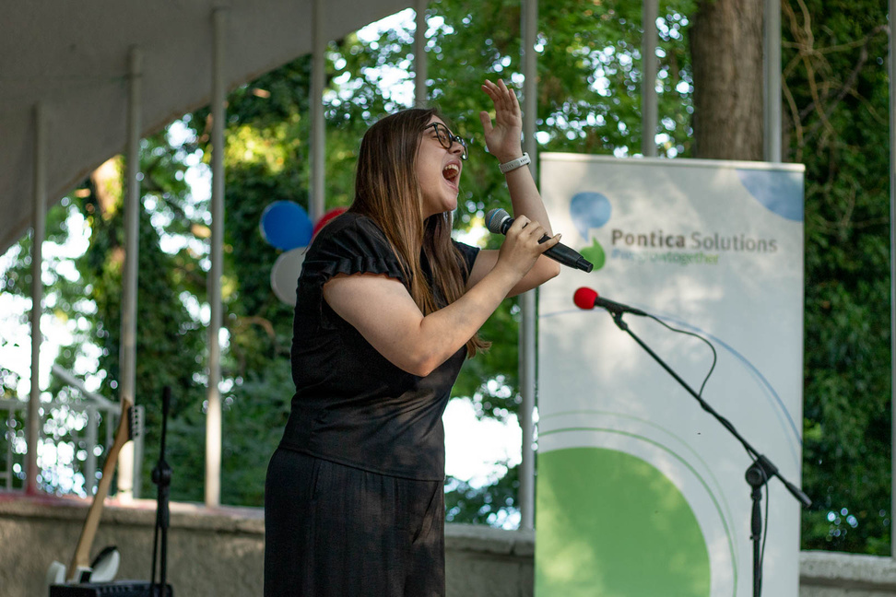
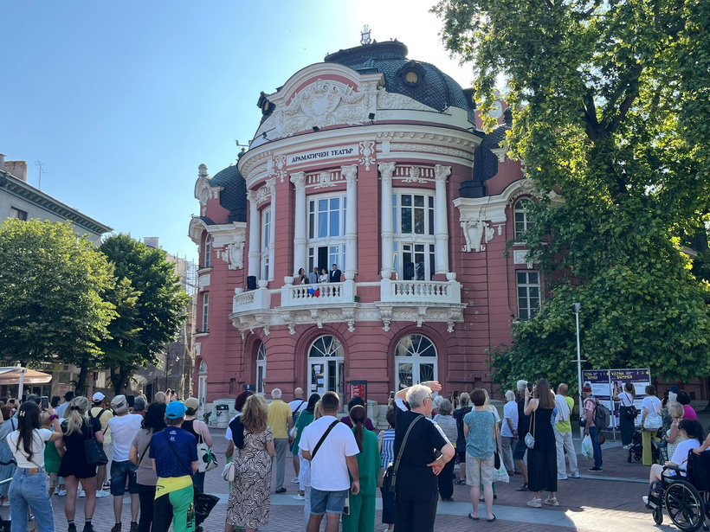
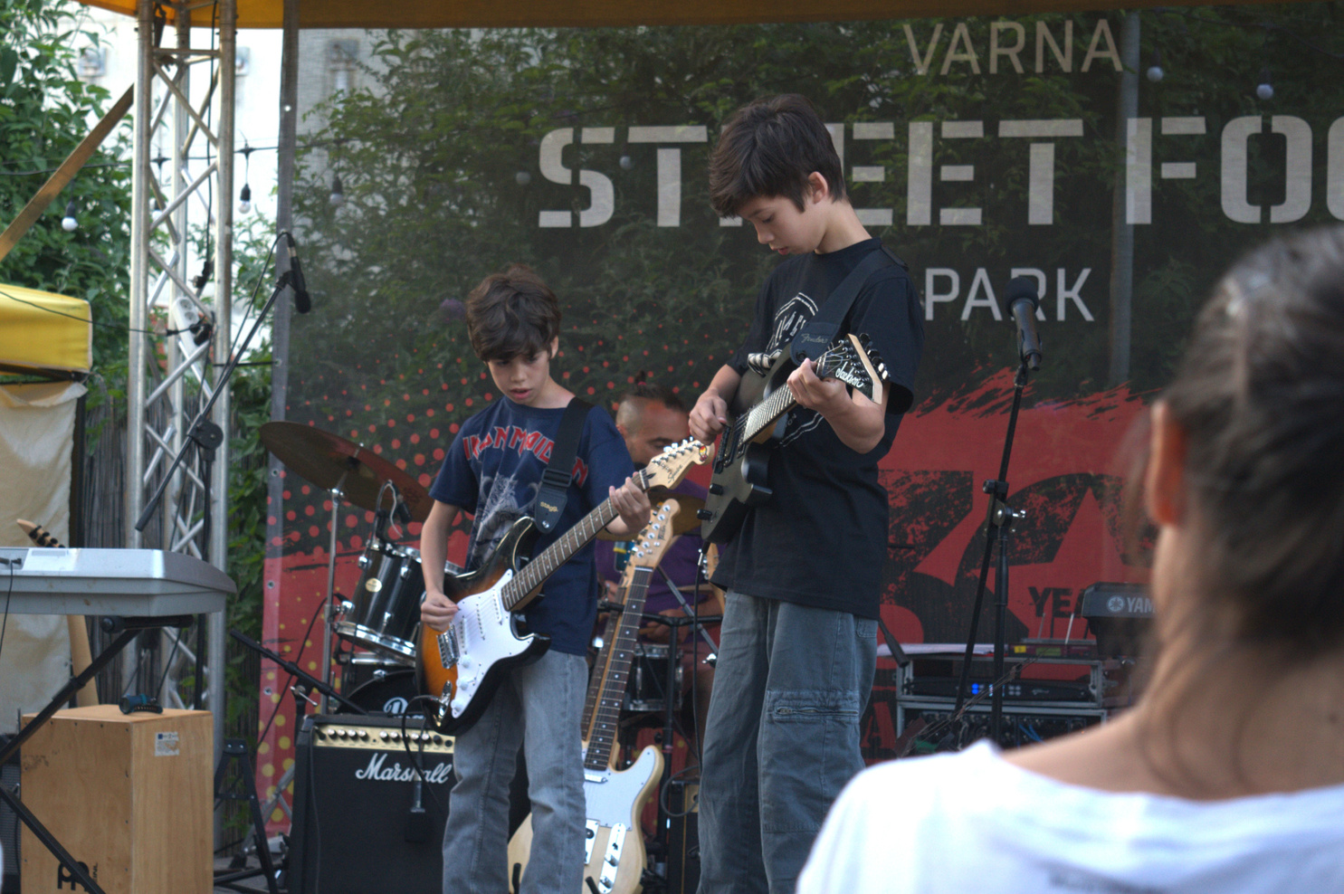
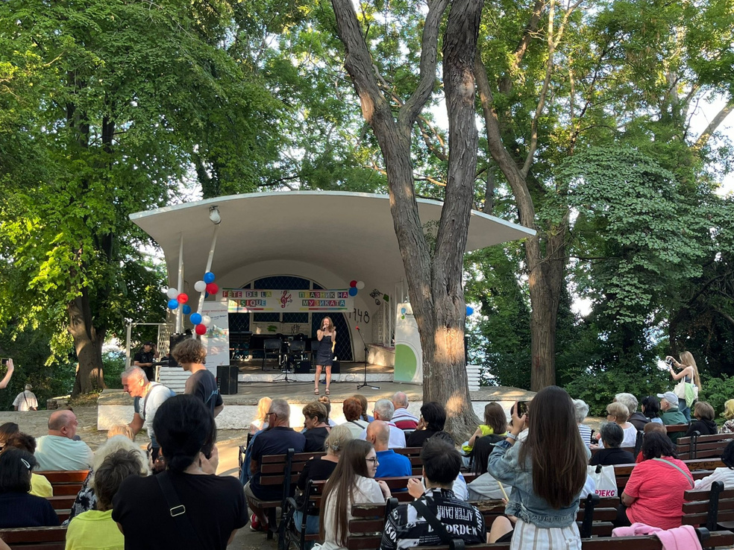
Fête de la musique
In partnership with the municipality of Varna and the Varna Opera House
Every year on June 21, celebration of a popular French festivity in three locations: the Varna Opera House,
the Rakovina stage in the Sea Garden, and the Varna Street Food stage

Slide 10
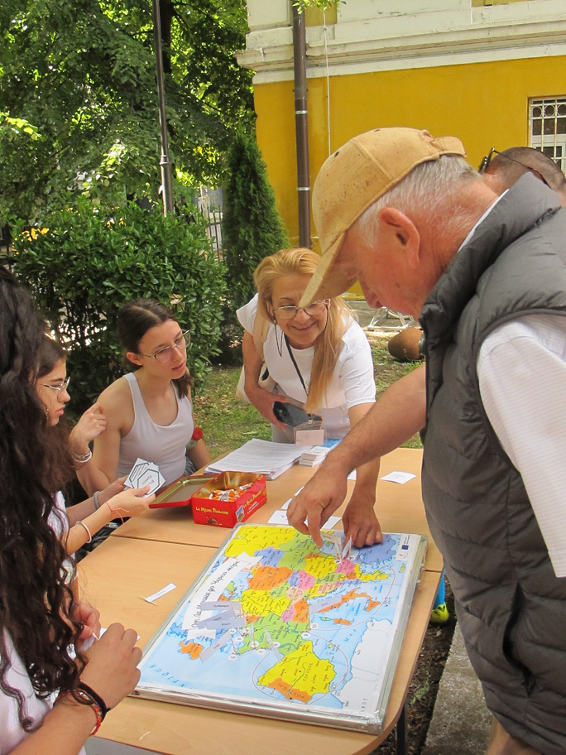
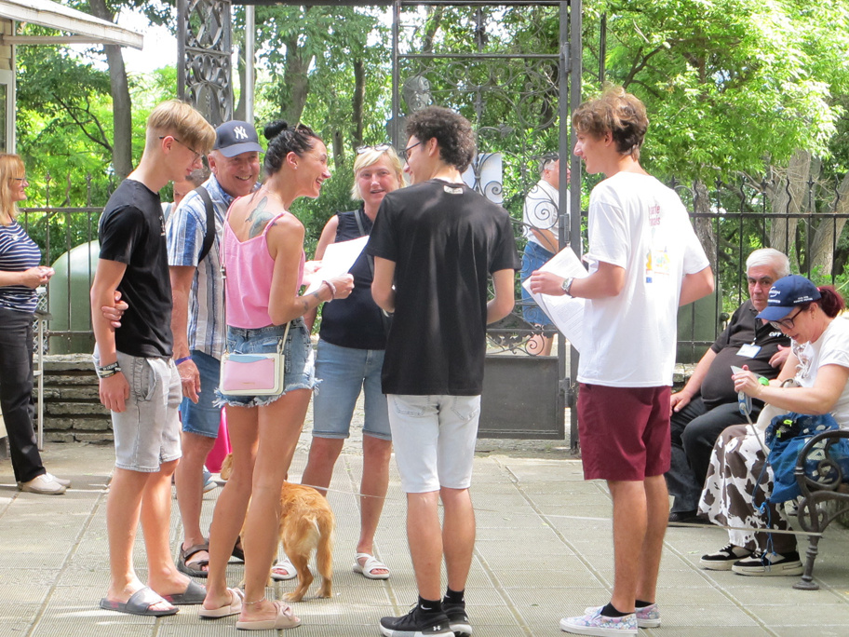
Father’s Day – Naval Museum
In partnership with the Naval Museum Varna
Presentation of the Franco-Bulgarian naval relations through playful activities offered to visitors

