Slide 1



2025 International Education Forum
Varna, October 9-10, 2025
Digital Education Modules 4 Participatory Planning
An innovative approach to participatory planning education and training
Nikolaos Gavanas, Assistant Professor
Scientific Coordinator
University of Thessaly, Volos, Greece

Slide 2

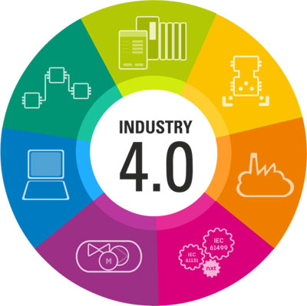
Main drivers
The pursuit of Sustainable Development Goals requires broad participation of society in decision making
Development and testing of an innovative modular curriculum, supported by the purposeful use of digital education tools, for teaching and training in Participatory Planning (PPL) and digital PPL tools, based on the needs and aspirations of HEIs.
https://sdgs.un.org/goals
Industry 4.0 offers a wide array of digital tools to support public engagement and participation
https://www.automate.org/editorials/industry-4-0-key-design-principles

Slide 3
Innovative elements of ModPPC
Interdisciplinary
Tourism management and planning (VUM)
Rural development and planning (UniLodz)
Land-use planning (POLITO)
Urban mobility (UTh)
Modular
Basic modules (BASIC)
Core subjects, common across disciplines and education levels
Flexible
Appropriate combination of modules to:
Design new courses from scratch
Support existing courses through the addition of modules and tools
Integrated
Courses designed for adaptation at all educational levels:
Undergraduate
Postgraduate
Life-Long-Learning
Optional modules-General subjects (OPT-G)
Focus on advanced knowledge and skills
Optional modules-Thematic subjects (OPT-T)
Specialised analysis on specific themes

Slide 4
The digital component
Catalogue digital PP tools and link them with specific modules
Enhance digital competence of:
Educators
Learners (students, practitioners)
Digital Tools for Participatory Planning
Advantages
enable stakeholders to engage in a project via a digital interface or technology
have become pivotal in enhancing stakeholder engagement across sectors, including urban planning, policy-making, and community development
provide multiple opportunities for stakeholder participation and can be used online or locally
enable inclusive participation by bridging geographical and demographic gaps, ensuring that diverse voices are heard and considered
lead to more informed decision-making, greater transparency, and a stronger sense of community ownership

Slide 5
The digital component
Catalogue digital PP tools and link them with specific modules
Enhance digital competence of:
Educators
Learners (students, practitioners)
Digital Tools for Participatory Planning
Challenges
Access to equipment and service & digital literacy
Engagement and interaction from the audience
Data privacy & security
Technical and technological capacity & unexpected technical issues
Cost & allocation of resources
Technological evolution & update/upgrade requirements

Slide 6
The digital component
Catalogue digital PP tools and link them with specific modules
Enhance digital competence of:
Educators
Learners (students, practitioners)
Digital Tools for Participatory Planning
Categorisation
Based on:
Purpose (e.g. modeling or planning support systems, opinion exchange platforms etc.)
Type of tool (e.g. social media, GIS, gamification, AR/VR etc.)
Technological features (e.g. visualization, documentation, surveying etc.)
Level of participation (information, consultation, involvement, collaboration, empowerment)

Slide 7
Implementation of the digital component in DEMo4PPL
Category | Tool | Link
Geographical information systems | ArcGIS Online | https://www.esri.com/en-us/arcgis/products/arcgis-online/overview
Participatory Governance | Your Priorities | https://www.citizens.is/your-priorities-features-overview/
Informative | OpenStreetMap | https://www.openstreetmap.org/
Interactive | adhocracy+ | https://adhocracy.plus/
 | Citizen OS | https://citizenos.com/platform/
 | DecSpace | http://app.decspacedev.sysresearch.org/#/
Collaboration | Miro | https://miro.com/
 | Mural | https://www.mural.co/
 | Trello | https://trello.com/
 | Moodle Platform | https://moodle.org
 | Slido | www.slido.com
 | Kahoot! | https://kahoot.com/
 | Mentimeter | https://www.mentimeter.com
13 DIGITAL TOOLS

Slide 8
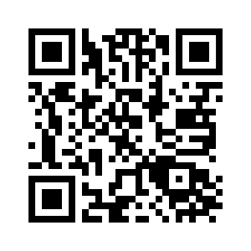
Implementation of the digital component in DEMo4PPL
The full Digital Toolkit is available from the DEMo4PPL Knowledge Hub (follow QR for open-access flip-book)
Module “Introduction to digital tools for PPL (BASIC2)” offers a theoretical background on Digital Tools for Participatory Planning
Selected digital tools are integrated as educational tools in 15 from 23 Modules
New tools were tested as part of DEMo4PPL seminars (e.g. PartiMap as part of training seminar)
The overall advancement of digital competences of educators was assessed by filling out the DigiCompEdu self-assessment form at 2 stages (before and after the pilot testing of Modules)

Slide 9
Innovation in practice
External evaluation of the curriculum by experts in PPL (CommonSpace-GR, Politopia-FR)
Train the Trainers Seminars by partners (VUM, UniLodz, POLITO) and experts (LabSus-IT, Energy Living Lab-CH)
Pilot of a large number of Modules at all levels (+ Erasmus students) in different disciplines and interdisciplinary courses
VUM
4 Modules
UniLodz
1 Module
1 Course (6 Modules)
POLITO
4 Modules
UTh
5 Modules

Slide 10
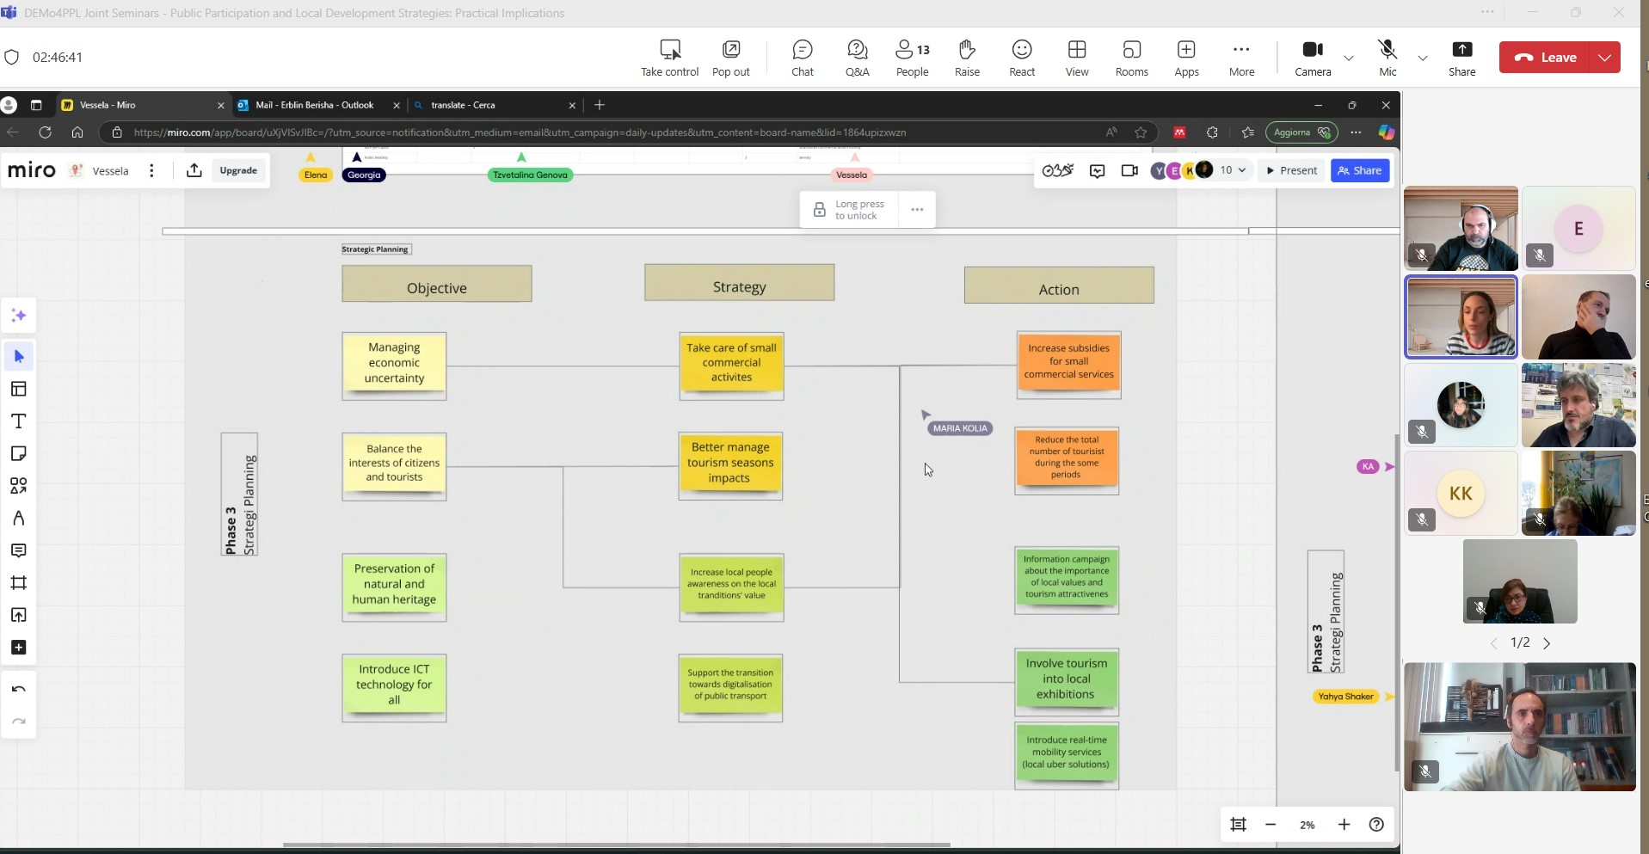
Innovation in practice
Joint seminar on the DEMo4PPL Basic Modules with the participation of educators and students from the 4 partner Universities
Local dissemination and engagement activities (incl. local PPL studios) – International Multiplier Event (Torino, 24 October 2025)
All material openly accessible through the
DEMo4PPL Knowledge Hub

Slide 11
Way forward
Short term indicators (1-year perspective) | Long-term indicators (5-year perspective)
Number of scientific, educational, or professional conferences presenting their DEMo4PPL-related achievements (At least 5 conferences in total at the consortium level, and preferable 1 per partnering institution) | Number of modules developed within the ModPPC and integrated by partnering institutions into undergraduate, postgraduate, or vocational education programmes (At least 10 modules in total at the consortium level, and at least 2 per higher education institution involved)
Number of academics involved in co-authoring an educational article to be published in a pedagogical journal or scientific journal (At least 5 academics in total at the consortium level, and preferably 1 per higher education institution involved) | Number of visits to the project website. Expected values (At least 1,000 visits in total, with a minimum of 200 visits per year)
Number of joint initiatives using the consortium’s organisational capacity to build on and continue collaboration in the future (At least 1 joint application submitted under the Erasmus+ or the other EU co-funded programme)

Slide 12




Contact details
 | https://www.demo4ppl.eu/
 | info@demo4ppl.eu
 | https://www.facebook.com/demo4ppl
 | https://www.linkedin.com/in/demo-4ppl-165733306/
Thank you!

