Slide 1

Future settlements on the Moon and Mars
Naval Academy Bulgaria: NVNA / NAB - LNTC
Project Name: LUNARTEC ( LUNAr Research and navigation TEchnology Center )
4 Letter Key: LNTC
Team Key: NVNA / NAB

Slide 2
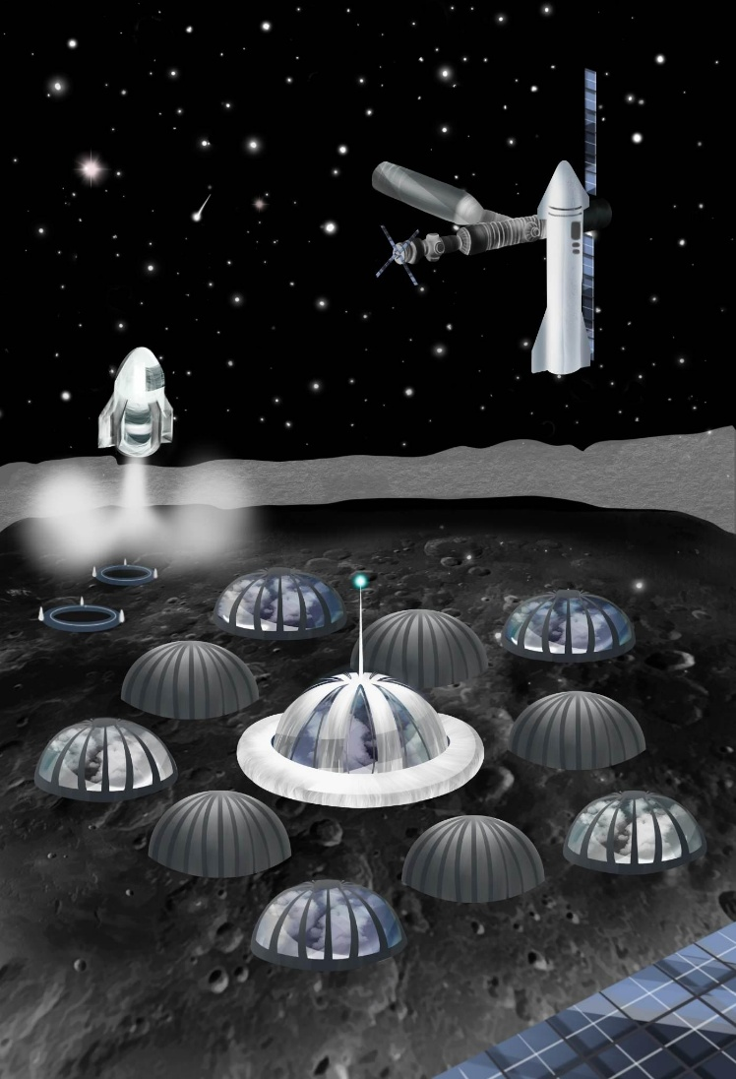
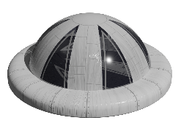
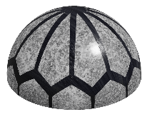
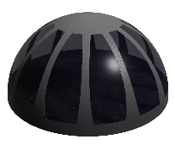
LUNARTEC Base
Naval Academy Bulgaria: NVNA / NAB - LNTC
Model Description:
The base consists of 3 main layers:
 | The first layer is the core of the lunar base. This is the logistics centre from which the main functions of the base are controlled. Decisions concerning missions on the Moon will be taken from here.
 | The second layer is reserved for science laboratories for five main scientific research divisions: Geoengineering and Geodesics, Biological Research, Astronomical Research, Engineering and Advanced Research.
 | The third layer consists of five living space biospheres, three of which are reserved for permanent inhabitants, one specialized as a training center and one of biospheres aimed at commercial purposes.

Slide 3
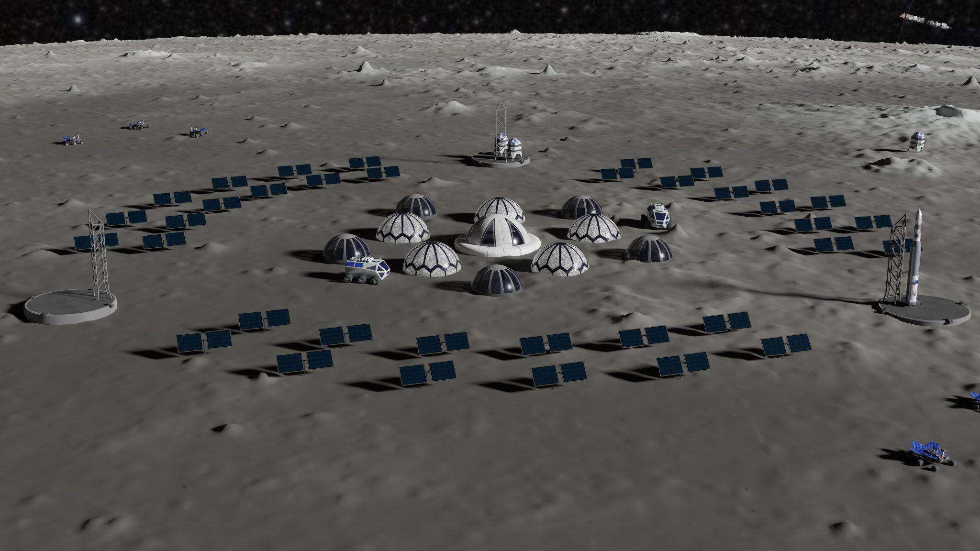
LUNARTEC Base
Naval Academy Bulgaria: NVNA / NAB - LNTC
Project Mission:
Explore the Moon’s composition and compile a full resource map
Extract resources from the Moon, relying less on launching heavy cargo from Earth
Examine the effects of the lunar environment on materials extracted and manufactured on the Moon
Astronomical observations on space weather, near Earth objects and objects in deep space
Promoting international cooperation and scientific exchange
Biological research

Slide 4
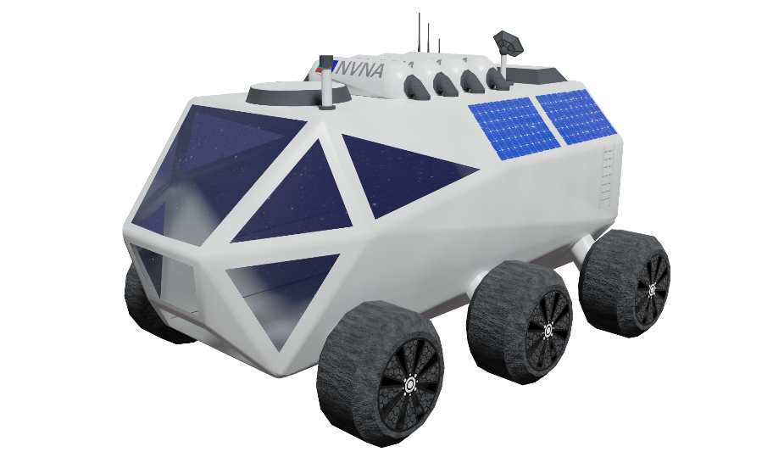
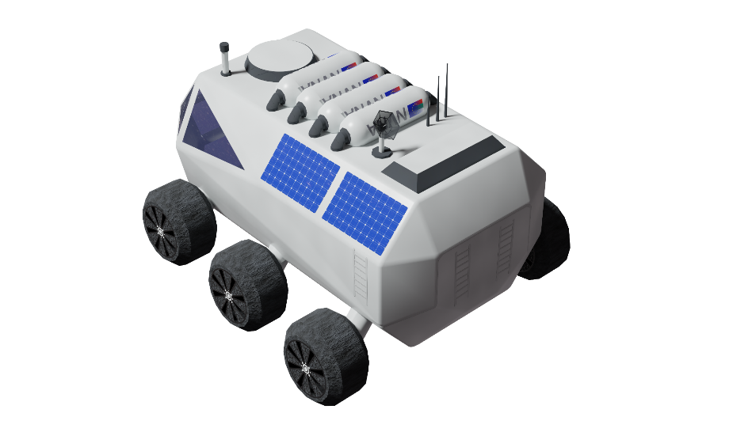
LUNARTEC Habitat Rover
Naval Academy Bulgaria: NVNA / NAB - LNTC
The Habitat Rover will be the main vehicle for transportation of astronauts, scientists and large amounts of pressurized cargo on the surface of the Moon. It is equipped with tools for repairing and maintaining critical components of the lunar base and will serve as a communication relay, extending radio access range.
Characteristics:
Size: 8.4m x 5.5m x 4.4m
High mobility
High carrying capacity
Solar power
Communications

Slide 5
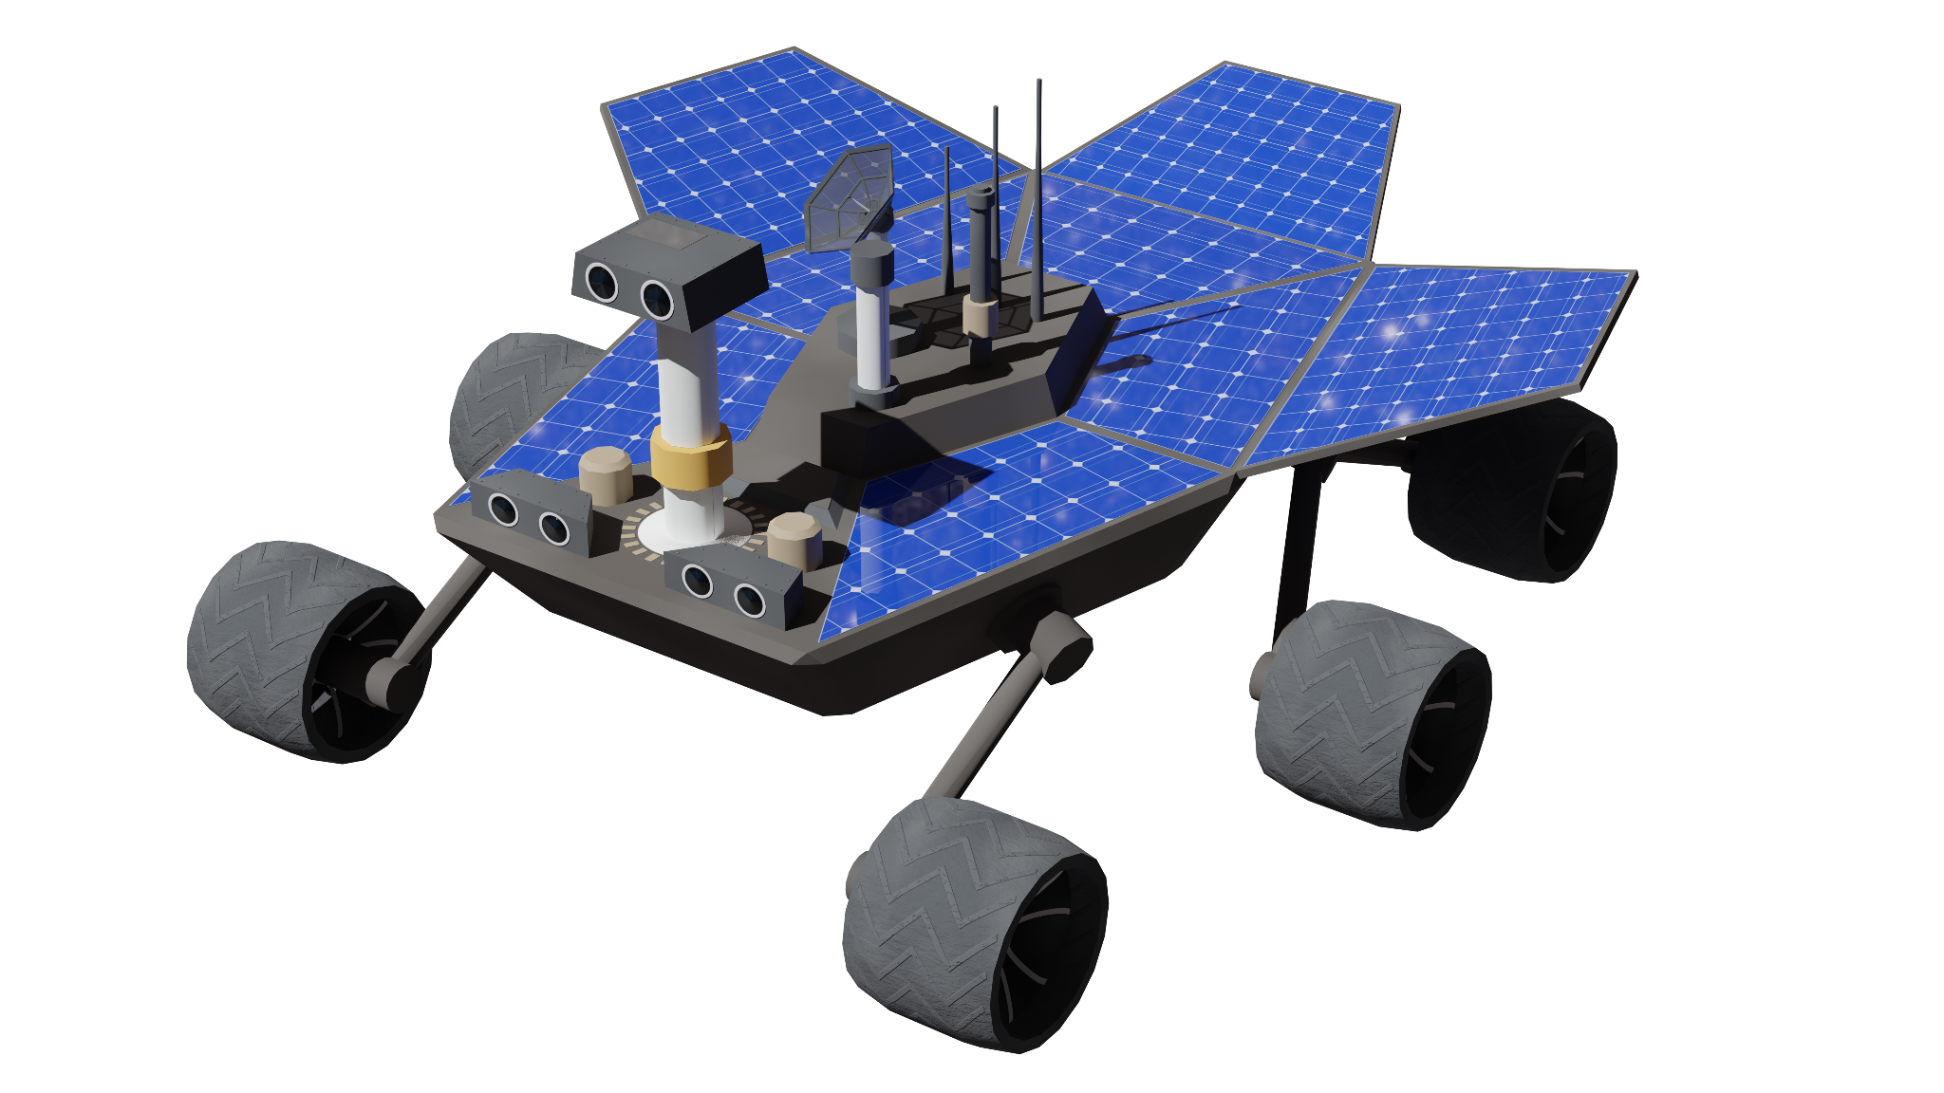
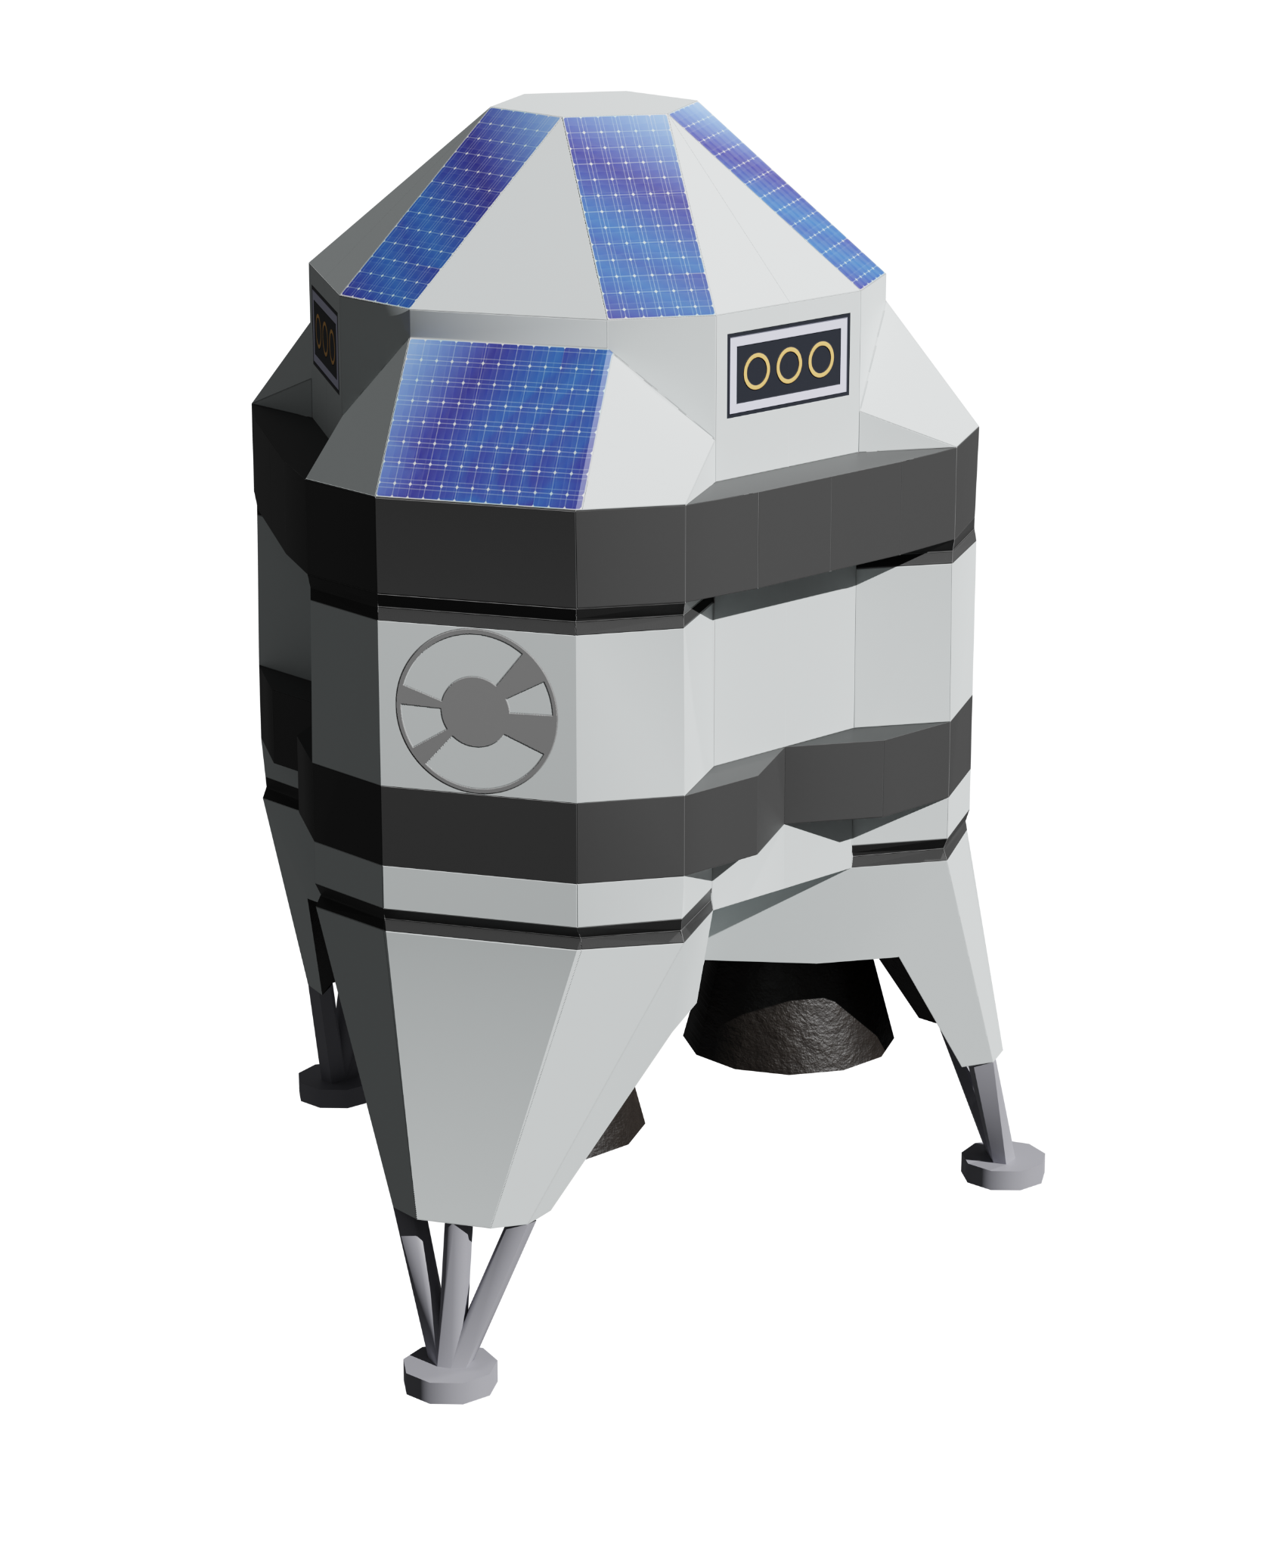
LUNARTEC
Explorer rover & Hopper
Naval Academy Bulgaria: NVNA / NAB - LNTC
The Explorer Rover will equipped with terrain scanners and scientific
tools for soil analysis. It’s purpose to explore specific routes, leaving
containers with samples for further experiments at a specific
locations along the route, which will be transported by the Hopper to the main base. The Hopper will navigate by making partial jumps low elevation orbit to the container left by the rover. An onboard robotic arm will be used to collect the requested objects.
Explorer rover Characteristics:
Solar power
Terrain mapping
Chemical analyzer
Hopper Characteristics:
Extreme mobility
High carrying capacity
Robotic arm

Slide 6
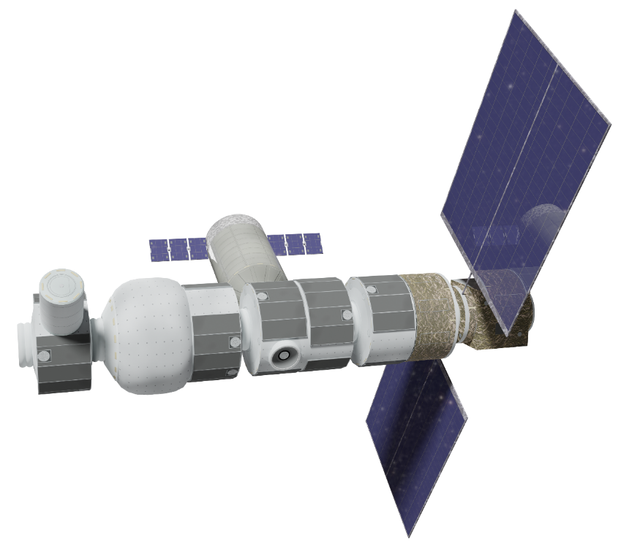
LUNARTEC
Gateway
Naval Academy Bulgaria: NVNA / NAB - LNTC
The Gateway represents the Artemis mission orbital lunar gateway, which will be an important asset for Moon missions and sustainable colonies.
Gateway Characteristics:
Orbital outpost
Communication
Research sharing

Slide 7
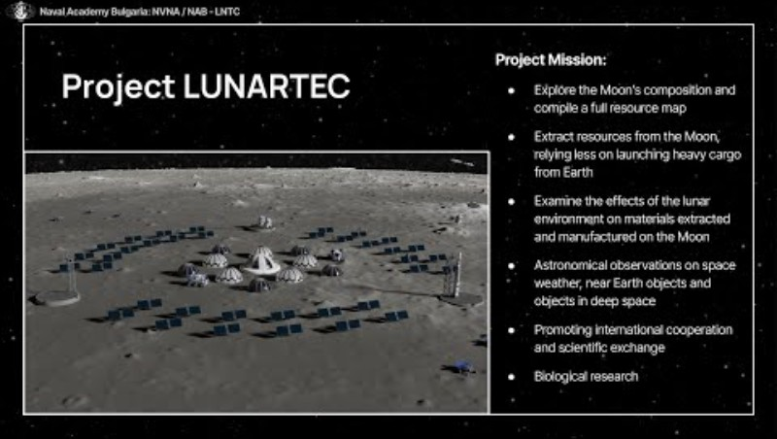
LUNARTEC 2023

Slide 8
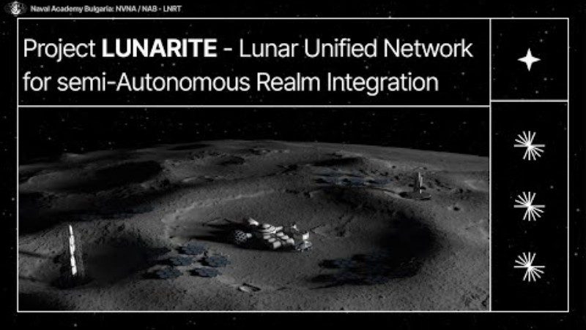
LUNARITE 2024

Slide 9
Thank you for your attention
Naval Academy Bulgaria: NVNA / NAB - LNTC

