Slide 1
"The City as a Study Site. Utilizing the Urban Environment for Modern and Quality Education"
Carsten Eidmann
-born 1965
-married to a bulgarian woman
-one son 18 years
-mechanical engineer
-in the automotive industry since 1996
-since 2001 BMW-Group, development new automobiles
-since 2017 Leader total vehicle, eight years geometrical design, actual hardware verification
Living in Munich, approx. 1.6 mill. inhabitants.

Slide 2
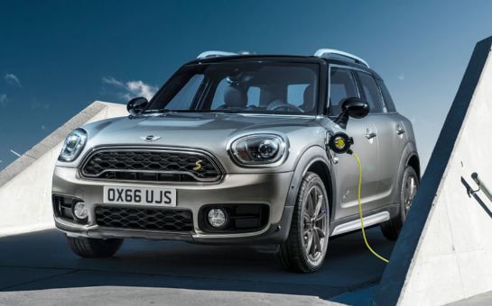
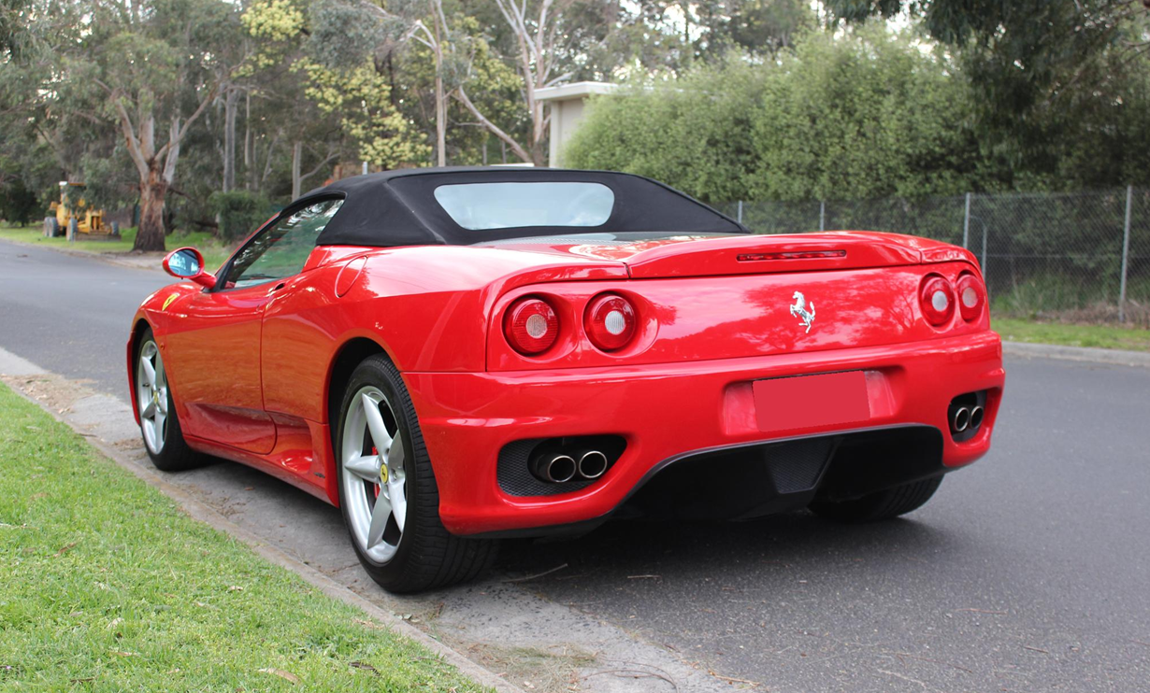
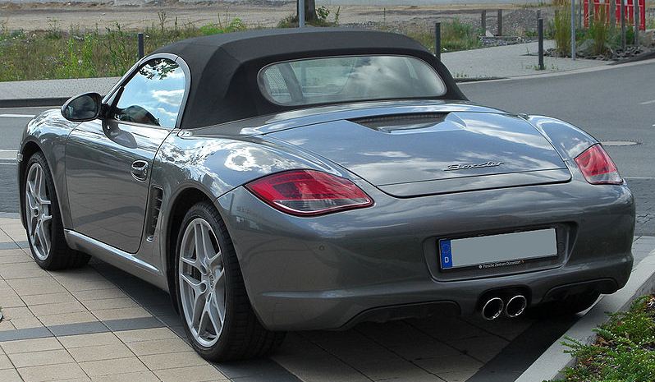
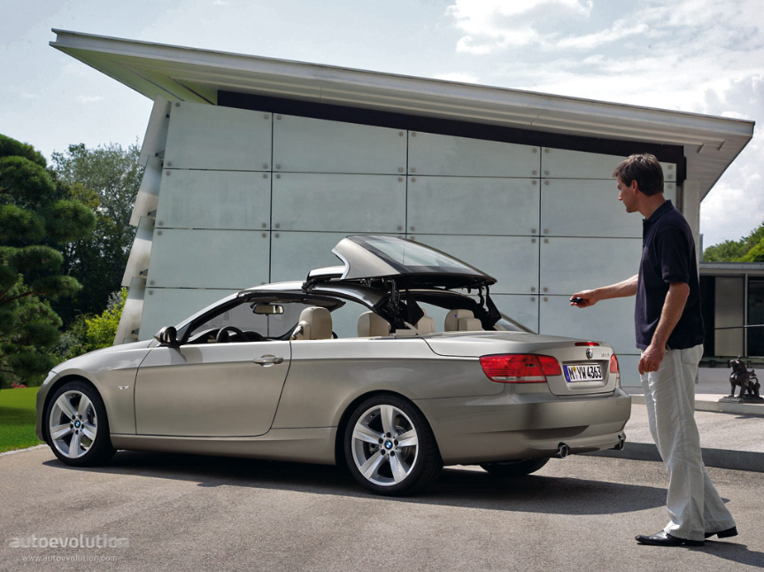
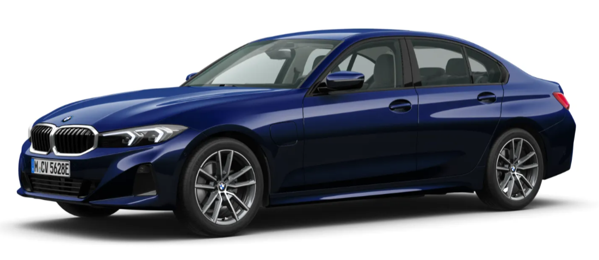
"The City as a Study Site. Utilizing the Urban Environment for Modern and Quality Education“ a few cars I worked for:

Slide 3
"The City as a Study Site. Utilizing the Urban Environment for Modern and Quality Education“ key points on automotive safety
There is a huge progress in automotive safety in the last 30 years caused by innovation and regulation requirements:
-seatbelt-warnings
-airbags
-deformation zones
-high strenght-steel in the car body
-driver assistance like ABS, ESP, automated driving, front collision warning etc
-…….
Average ~ 3mill. car accidents for 83.5 mill. inhabitants in Germany
1995: 2024:
~10.000 killed, 393.000 injured 2770 killed, 290.700 injured
_{Rate: 30 per million}
Average age of cars:
Germany: 10.6 years
Bulgaria: 19 years
Bulgaria 2024: 478 killed for 6.4 mill. inhabitants. Rate: 74 per million

Slide 4
"The City as a Study Site. Utilizing the Urban Environment for Modern and Quality Education“ key points on automotive safety
There is a huge progress in automotive safety in the last 30 years caused by innovation and regulation requirements, but:
-there is no 100% safety in traffic
-car installed speed limit helps only for brandnew cars and is a matter of regulation
-up to now only the driver is responsible
-safety depends mostly on the discipline and the foreward-seeing driving style and….
-good driving education and training
-no use of smartphones or tablets in traffic

Slide 5
"The City as a Study Site. Utilizing the Urban Environment for Modern and Quality Education“ what can we do?
Topic solution responsible
Child safety in car: child seat and closed seatbelt parents!!
Child safety in town: education of rules and practise! parents an educators
Youth safety (bike, scooter): education, discipline and practise parents an educators
Young car driver: driver training, discipline parents
Most important:
Adults must be ALWAYS a positive example!
This requires uncomfortable discipline, e.g. never drive without closed seatbelt, helmet, …..!
Check the brakes, tires, lights, ……

Slide 6
"The City as a Study Site. Utilizing the Urban Environment for Modern and Quality Education“ conclusion:
In my oppinion:
-city traffic is dangerous
-children must be guided and educated for correct behavier in traffic
-this takes time and attention
-it is worth it!!!

Slide 7
"The City as a Study Site. Utilizing the Urban Environment for Modern and Quality Education"
Thank you for Your attention!

