Slide 1
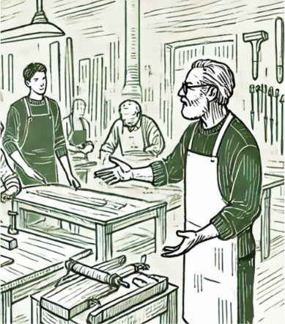

NON-FORMAL EDUCATION × LIVING HERITAGE
The Role of Non-Formal Education
in the Transmission of
Traditional Knowledge
ADD COVER IMAGE
Insights from the EU-funded projects BRICKS and BIOSUSTAIN
Maka Dvalishvili · Tamar Kiknadze
Georgian Arts and Culture Center (GACC) · Varna 2026

Slide 2
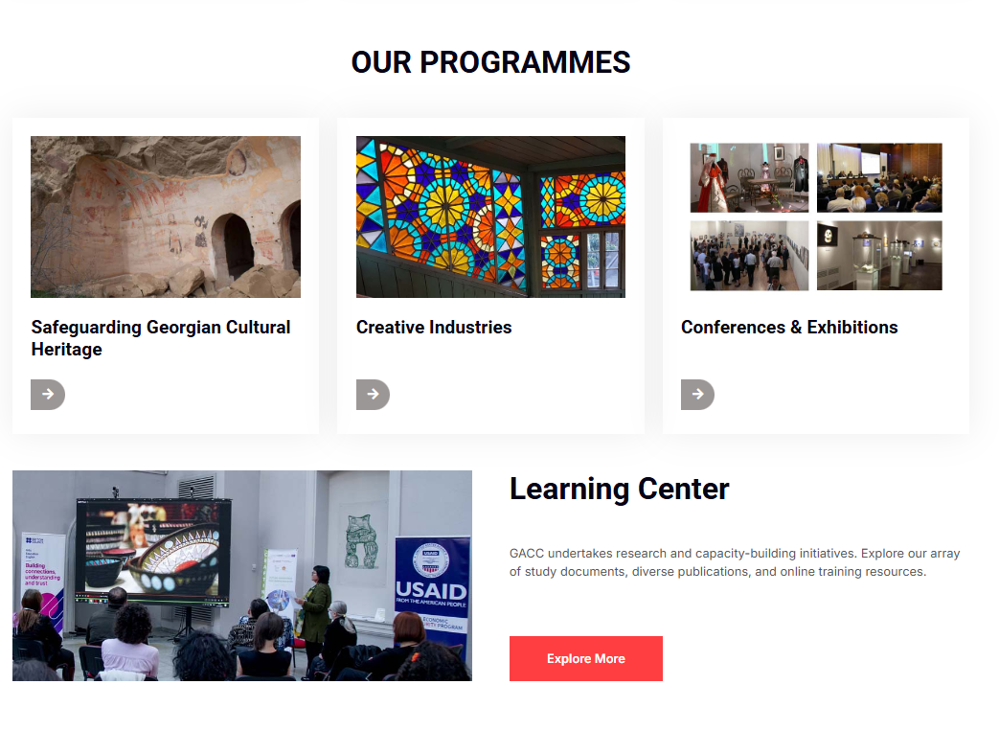
OUR ORGANISATION
About GACC
Since 1995
GACC safeguards cultural heritage while strengthening crafts, creative industries and community-based development.
01
UNESCO-accredited NGO for Intangible Cultural Heritage
02
Member of the European Crafts Alliance
03
Official representative of Europa Nostra in Georgia
The Role of Non-Formal Education in the Transmission of Traditional Knowledge
02

Slide 3
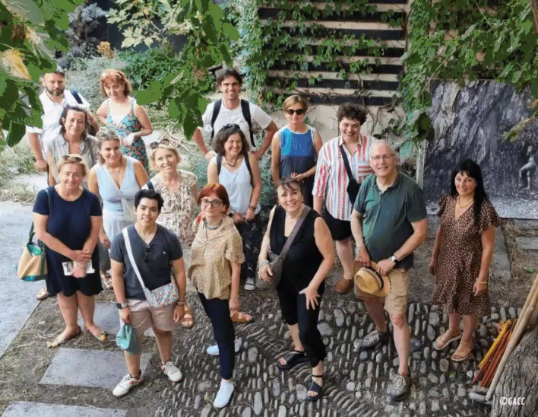
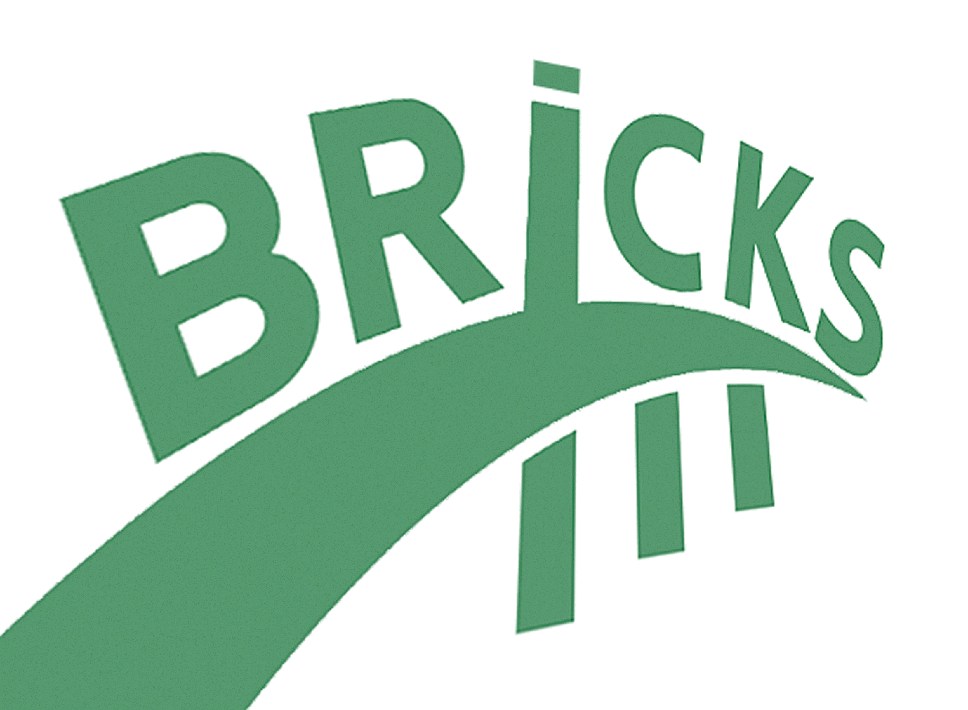

Projects
BRICKS
Building Bridges, Building Skills: Enhancing Non-Formal
Craft Education for Sustainable Cultural Transmission
December 2025 – June 2027
Co-Funded by:
EU Erasmus+ programme
Project Partners:
Made in Europe (Belgium)
Artex (Italy )
Georgian Arts and Culture Center (Georgia)
Ethnographic Department, National Museum of
Gdansk (Poland)
The Role of Non-Formal Education in the Transmission of Traditional Knowledge
02

Slide 4
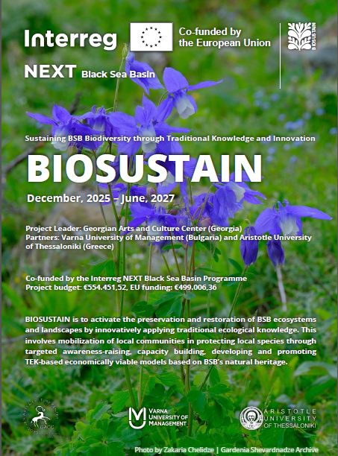


Projects
BIOSUSTAIN
Sustaining BSB Biodiversity through Traditional Knowledge and Innovation
December 2025 – June 2027
Co-Funded by:
The Interreg NEXT Black Sea Basin Programme
Project Leader:
Georgian Arts and Culture Center (Georgia)
Project Partners:
Varna University of Management (Bulgaria)
Aristotle University of Thessaloniki (Greece)
The Role of Non-Formal Education in the Transmission of Traditional Knowledge
02

Slide 5
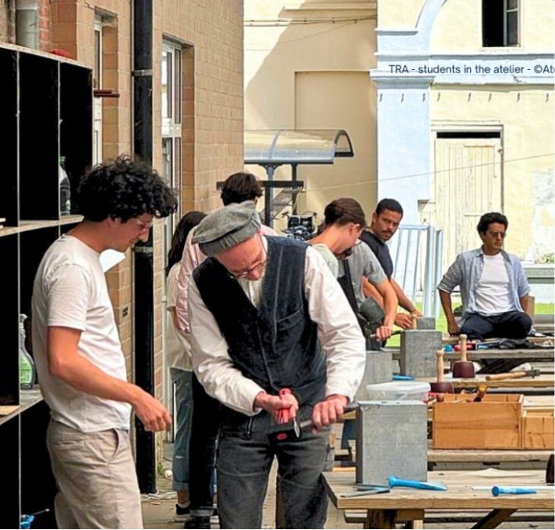
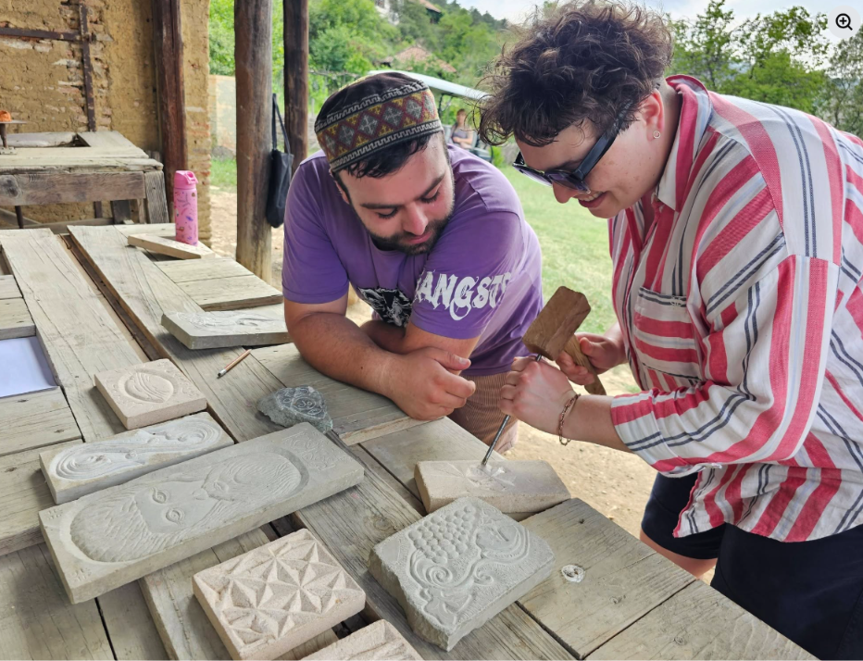
WHY IT MATTERS
Traditional knowledge lives through people and practice
It connects heritage crafts, ecological knowledge, local food and plants, sustainable resource use and community resilience.
LIVING
PRACTICAL
COMMUNITY-BASED
EXPERIENCE-DRIVEN
ADD DETAIL IMAGE
The Role of Non-Formal Education in the Transmission of Traditional Knowledge
03

Slide 6
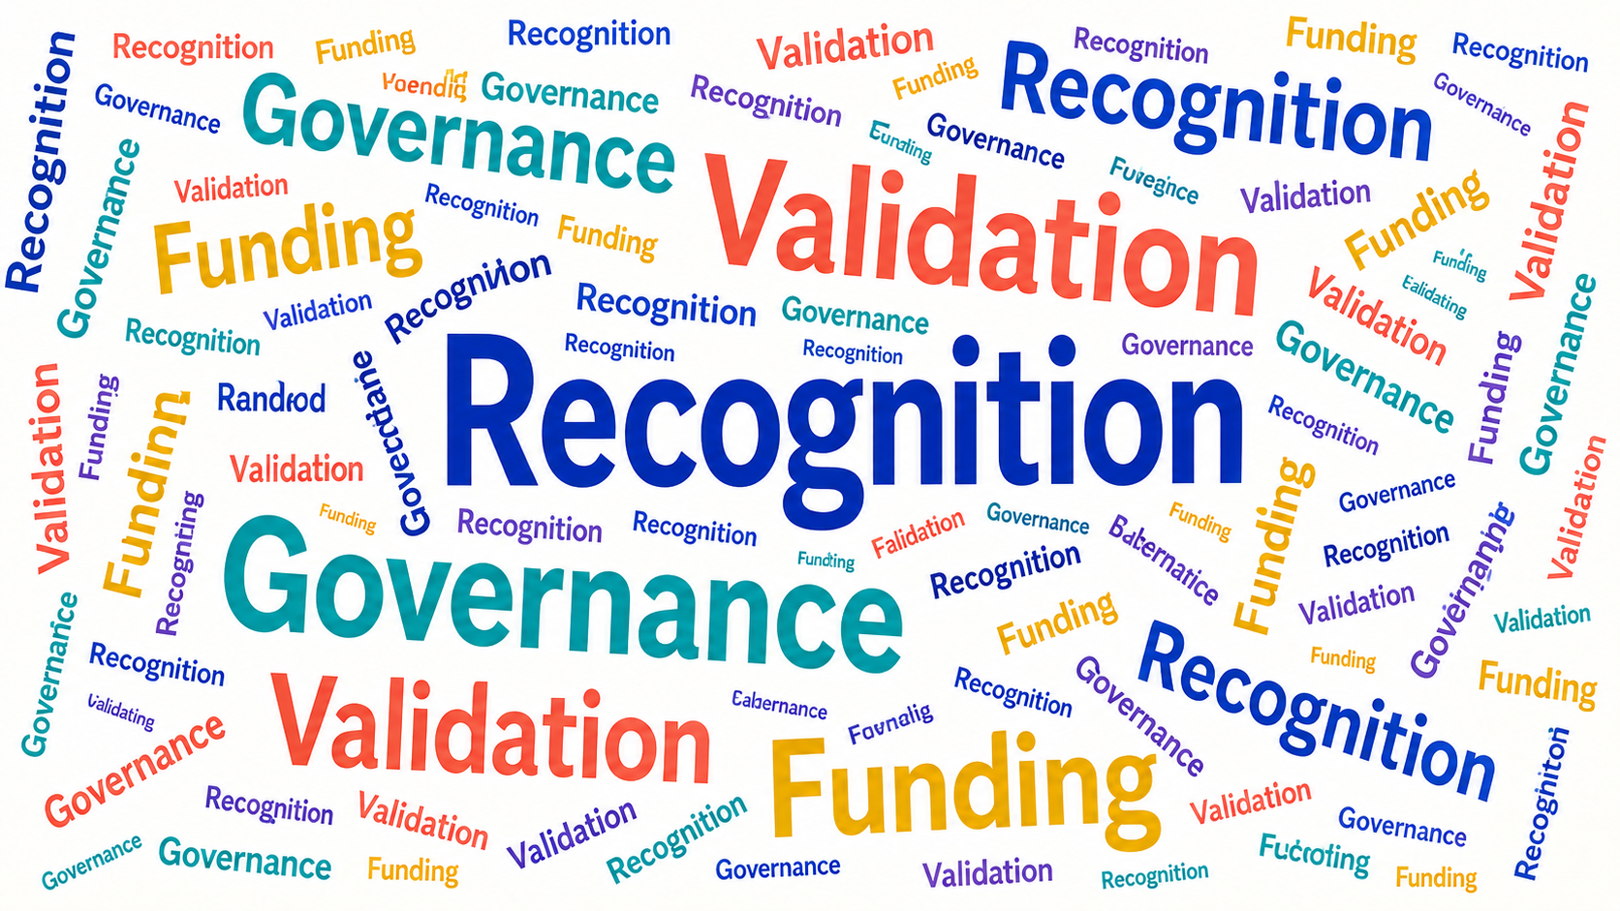
BRICKS FINDING
Recognition is growing — but support remains weak
Across Europe
Non-formal education is increasingly recognised within lifelong learning, skills development and social participation.
The gap
Recognition, validation, governance and funding remain uneven — and no BRICKS country has a comprehensive craft-specific framework.
The Role of Non-Formal Education in the Transmission of Traditional Knowledge
04
Notes:
Sources]
BRICKS Final Consolidated Report, pp. 18–21 and 49.

Slide 7
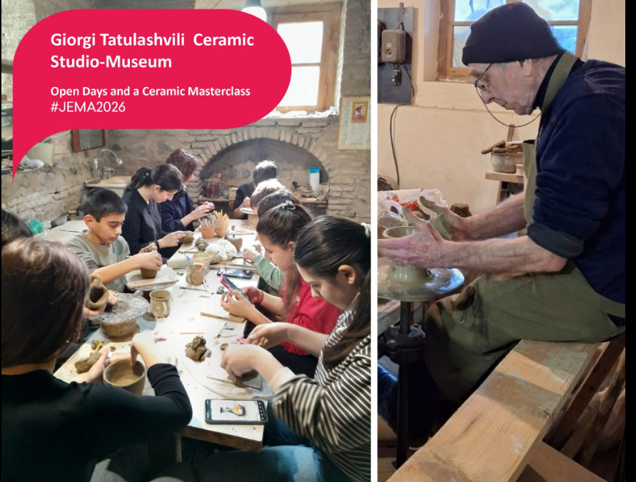
HOW LEARNING HAPPENS
Craft knowledge travels through flexible learning pathways
01
Workshops & masterclasses
02
Apprenticeship & mentorship
03
Learning in craft enterprises
04
Museums & community spaces
05
Family & peer transmission
06
Online learning & mobility
The Role of Non-Formal Education in the Transmission of Traditional Knowledge
05
Notes:
[Sources]
BRICKS Final Consolidated Report, pp. 22–32 and national annexes.

Slide 8
WHAT BRICKS SHOWS
The strongest systems connect formal structure with real practice
FORMAL EDUCATION
NON-FORMAL EDUCATION
Structure
Theory
Recognised progression
Flexibility
Practice
Professional and community context
The bridge: workshops · apprenticeships · museums · enterprises · community organisations
The Role of Non-Formal Education in the Transmission of Traditional Knowledge
06

Slide 9
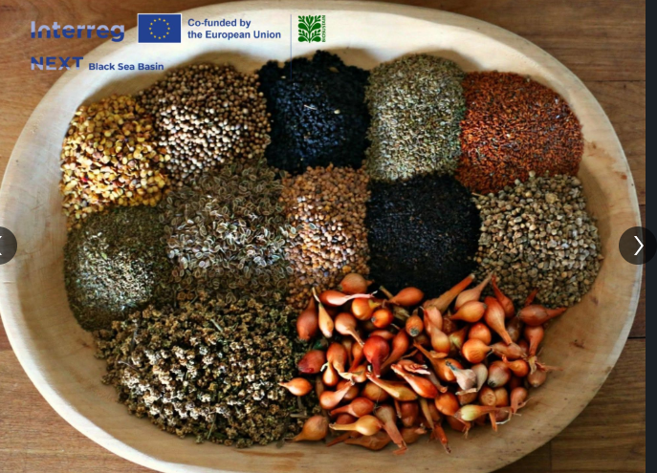
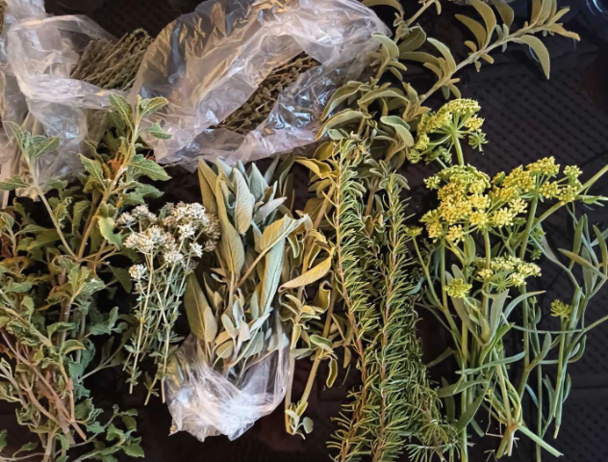
BIOSUSTAIN INNOVATION
The Experimentorium turns traditional knowledge into shared inquiry
01
02
03
04
SHARE
→
TEST
→
REFLECT
→
ADAPT
Community knowledge holders, craftspeople, researchers and students learn by doing — comparing traditional applications, observing results and discussing responsible adaptation.
A participatory learning space and a living laboratory
The Role of Non-Formal Education in the Transmission of Traditional Knowledge
ADD LOGOS
07
Notes:
[Sources]
BIOSUSTAIN project materials and user-provided BIOSUSTAIN presentation.

Slide 10
EXPERIMENTORIUM METHOD
Six phases turn participation into a repeatable learning model
01
Frame the theme, species and ethics
02
Demonstrate the traditional practice
03
Document it with a TEK Practice Card
04
Test and innovate in small groups
05
Refine and evaluate applications
06
Validate with the community and present
The Role of Non-Formal Education in the Transmission of Traditional Knowledge
7A
Notes:
[Sources]
BIOSUSTAIN, Common Methodology for Conducting the National and International Experimentoriums, pp. 7–16 (working principles, roles, six-phase implementation and TEK Practice Card).

Slide 11
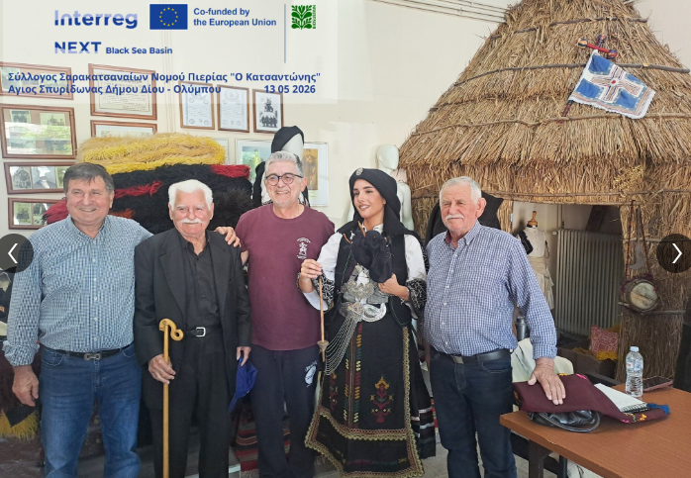
SHARED CHALLENGES
Different fields reveal the same transmission barriers
1
Ageing knowledge holders
2
Weak youth entry routes
3
Limited visibility and recognition
4
Short-term funding and unequal access
5
Fragmented governance and insufficient data
Knowledge survives only when people have places, resources and recognition to practise and transmit it.
The Role of Non-Formal Education in the Transmission of Traditional Knowledge
08
Notes:
[Sources]
BRICKS Final Consolidated Report, pp. 3–12 and 48–52; BIOSUSTAIN project materials.

Slide 12
SHARED LESSONS
Four principles can strengthen living knowledge
01
RECOGNISE
02
ENABLE
Treat non-formal learning as indispensable.
Support learners, educators and community spaces.
03
CONNECT
04
LEARN BY DOING
Bridge education, heritage, research and practice.
Use participatory formats such as Experimentoriums.
BRICKS × BIOSUSTAIN
ADD LOGOS
09
Notes:
[Sources]
BRICKS Final Consolidated Report, pp. 48–52; BIOSUSTAIN project materials.

Slide 13
POLICY DIRECTIONS
Policy should build stronger learning ecosystems
01
Recognition
Accessible validation and recognition of prior learning
02
Sustainable support
Investment in learners, educators and learning spaces
03
Quality & visibility
Pedagogical support and clearer learning pathways
04
Coordination & evidence
Connected policies, mapping, monitoring and data
The Role of Non-Formal Education in the Transmission of Traditional Knowledge
10
Notes:
[Sources]
BRICKS Final Consolidated Report, pp. 49–52.

Slide 14
TRADITIONAL KNOWLEDGE CANNOT BE SAFEGUARDED BY DOCUMENTATION ALONE.
It survives when it is
shared · practised · tested
adapted · reinterpreted
passed to another generation
THANK
YOU!
Non-formal education creates the human space in which living heritage continues to live.
Notes:
[Sources]
BRICKS Final Consolidated Report; BIOSUSTAIN project materials.

