Slide 1

STEAM Education in Early Childhood Education
INTERNATIONAL EDUCATION FORUM
“EDUCATION OF THE FUTURE”
Alvina Maasik, Olga Janson-Kislitsõn
Arbu Kindergarten, Tallinn, ESTONIA
Varna, Bulgaria 2026

Slide 2
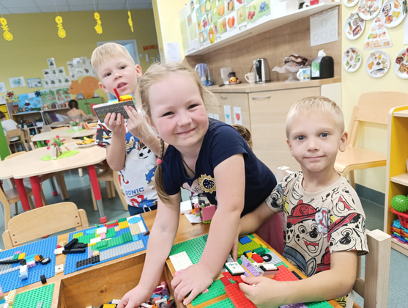
1. Why Is STEAM Important in Early Childhood Education?
STEAM combines Science, Technology, Engineering, Art and Mathematics.
Children are naturally curious. They ask many questions and learn best through play, exploration and hands-on activities.
STEAM education helps children to:
understand how the world works;
develop curiosity and creativity;
think critically and solve problems;
cooperate and share ideas;
become confident and independent learners;
prepare for future challenges.

Slide 3
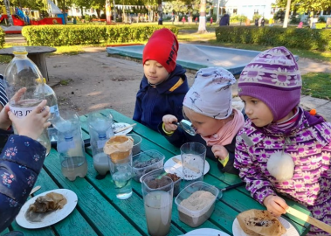
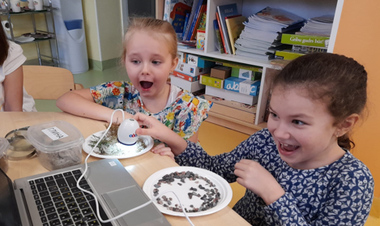
2. STEAM in Everyday Learning
STEAM is not a separate subject in our kindergarten. It is naturally integrated into children’s everyday learning and play.
Children observe, compare, measure, build, create, experiment and look for solutions. STEAM activities are connected with language learning, mathematics, art, nature and physical activity.

Slide 4
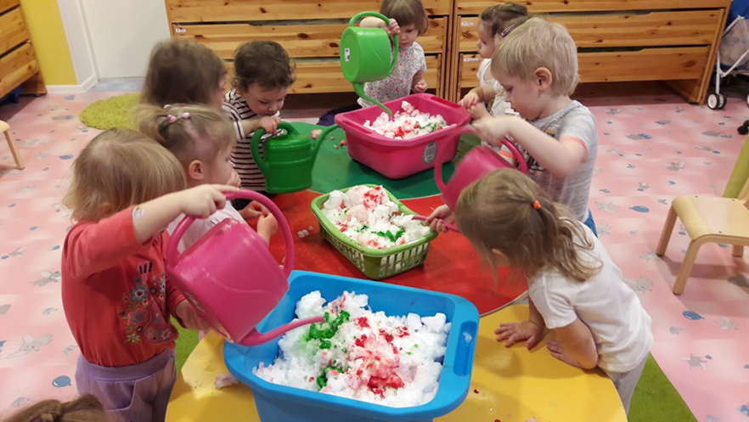
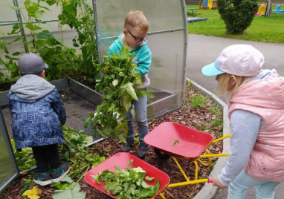
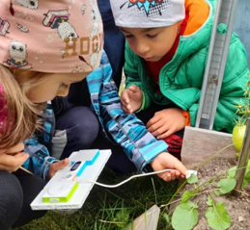
3. Science Through Experiments and Discovery
Children explore the world through observation and simple experiments.
They ask questions, make predictions, test their ideas and discuss the results.
Science activities develop curiosity, critical thinking and an understanding of natural phenomena.

Slide 5
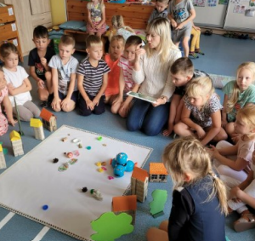
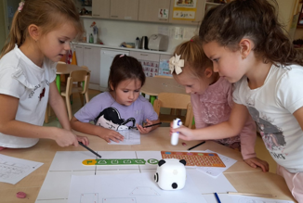
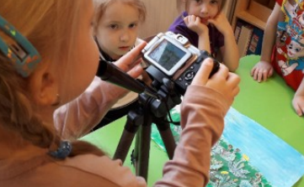
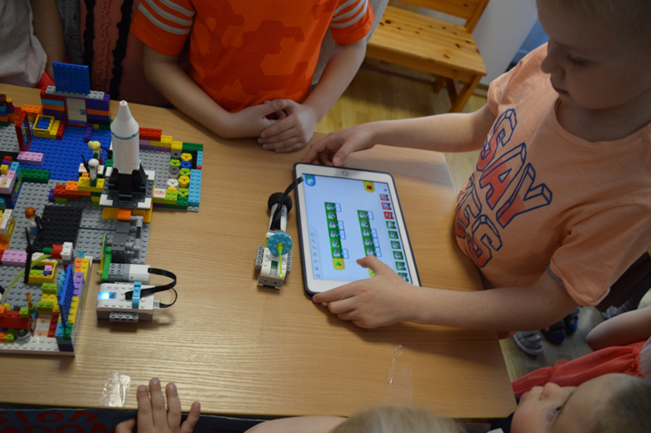
4. Technology and Educational Robotics
Digital tools support active learning:
educational robots;
coding and sequencing;
digital storytelling;
photography and video;
interactive learning games;
safe and age-appropriate technology use.

Slide 6
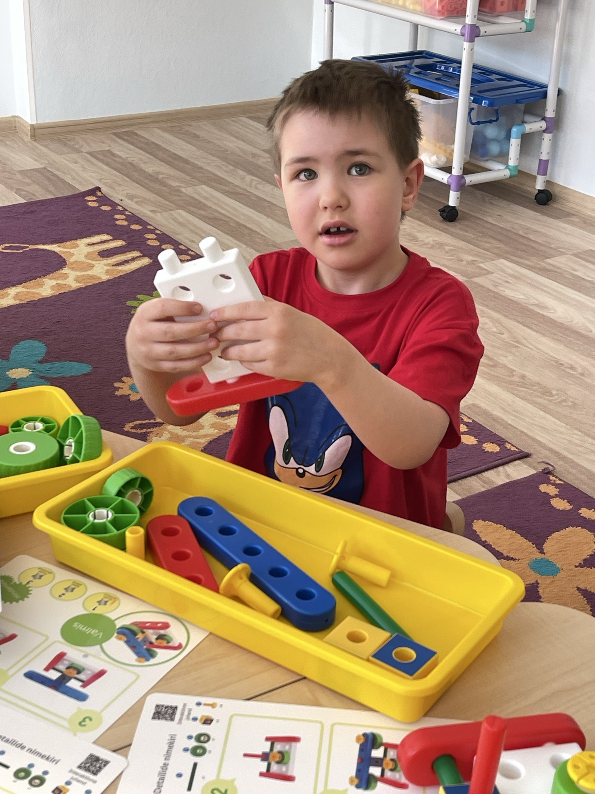
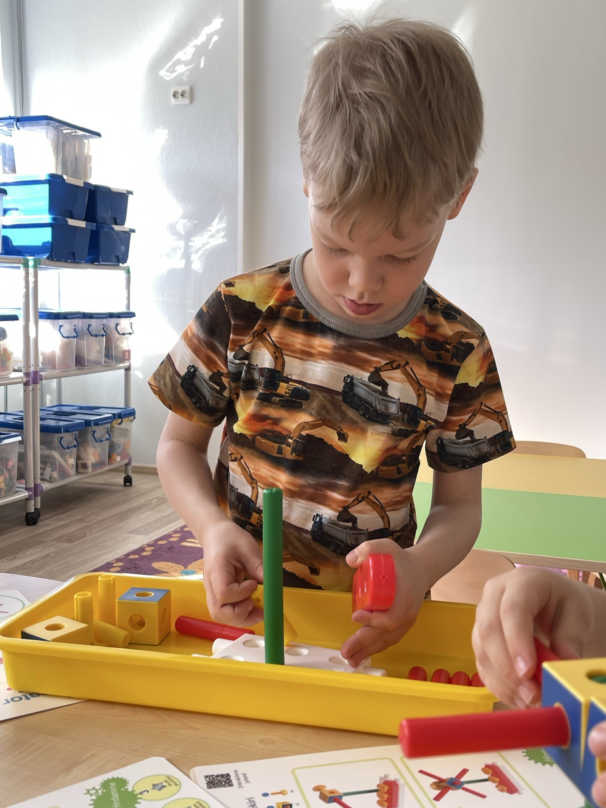
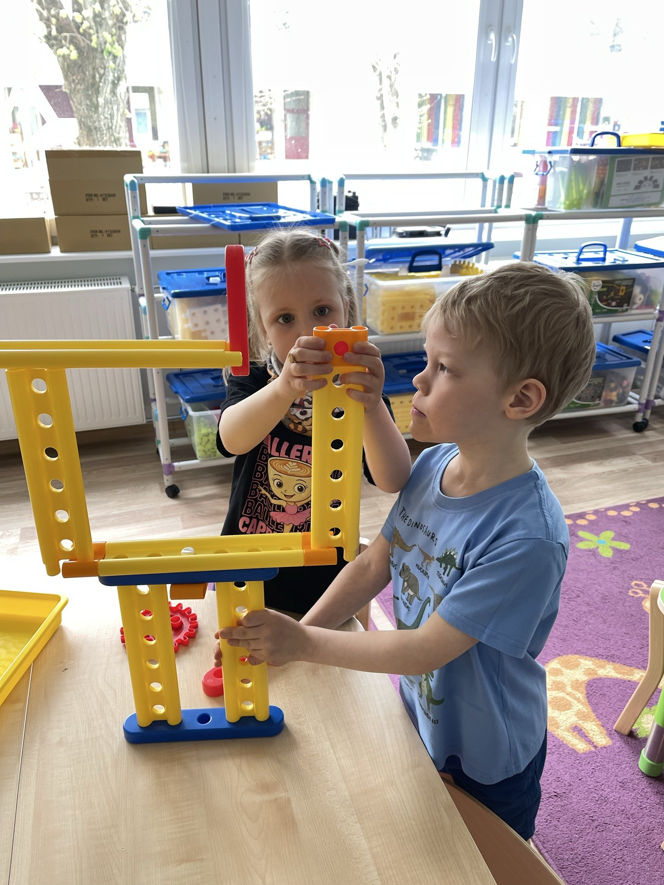
5. Engineering with Gigo and Construction Materials
Children learn through construction, experimentation and teamwork.
From an idea to a working model:
Imagine
Plan
Build
Test
Improve

Slide 7
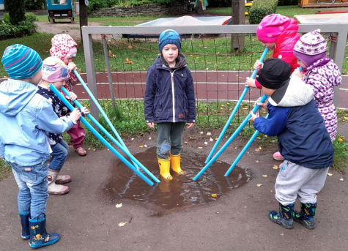
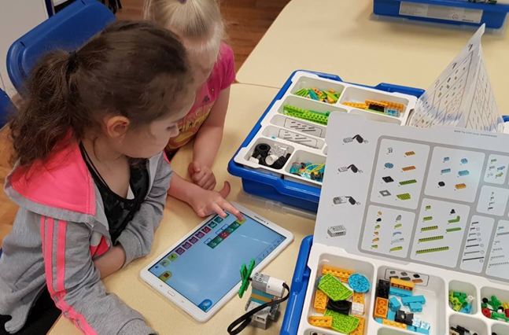
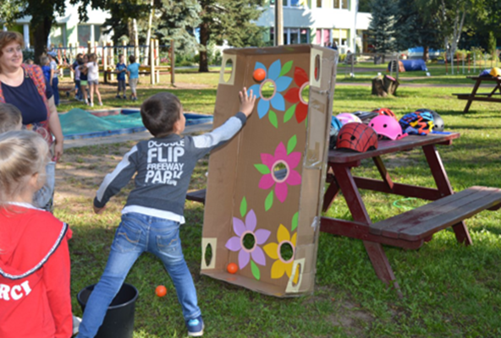
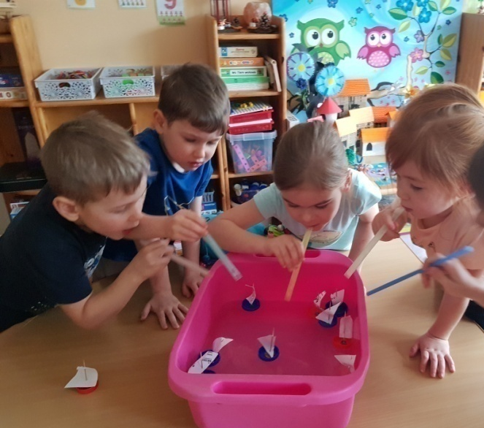
6. Mathematics Through Play
Mathematics is everywhere:
counting and comparing;
shapes and patterns;
measuring length, weight and volume;
sorting and classifying;
spatial relationships;
logical thinking and problem-solving.

Slide 8
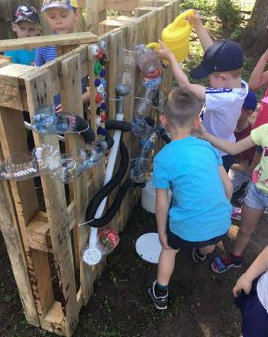
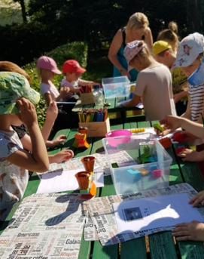
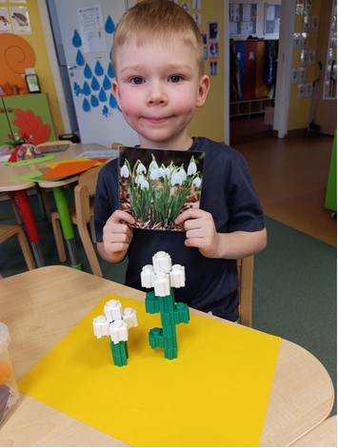
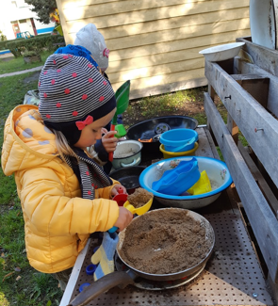
7. Art, Creativity and Outdoor STEAM
Creativity connects all STEAM areas.
art with natural and recycled materials;
designing and creating models;
outdoor experiments;
exploring plants, weather and seasons;
learning in the garden and greenhouse;
finding creative solutions.
Notes:
Art gives children an opportunity to express their ideas and make STEAM activities more creative.
Children design, draw, model and build using natural, recycled and traditional art materials. They learn that one task can have many different solutions.
Outdoor learning is also an important part of our approach. Children observe seasonal changes, explore plants and insects, investigate weather conditions and carry out experiments in nature.
Our garden, greenhouse, smart greenhouse and roof garden provide opportunities to connect science, mathematics, environmental education and creativity.
Photos
Творческие работы из природных материалов.
Работы из вторичного сырья.
Дети в саду, теплице или на крыше.
Наблюдение за растениями и насекомыми.
Эксперименты и измерения на улице.

Slide 9
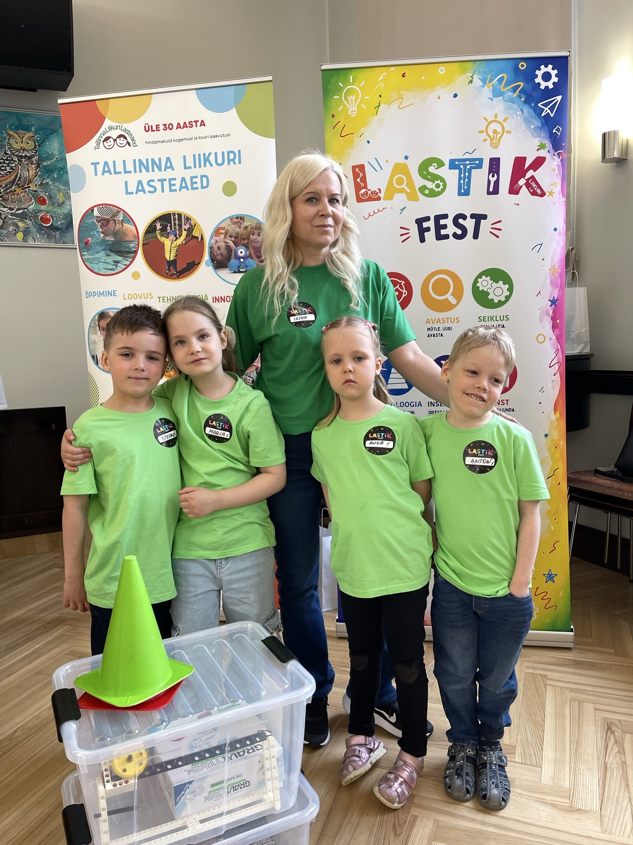
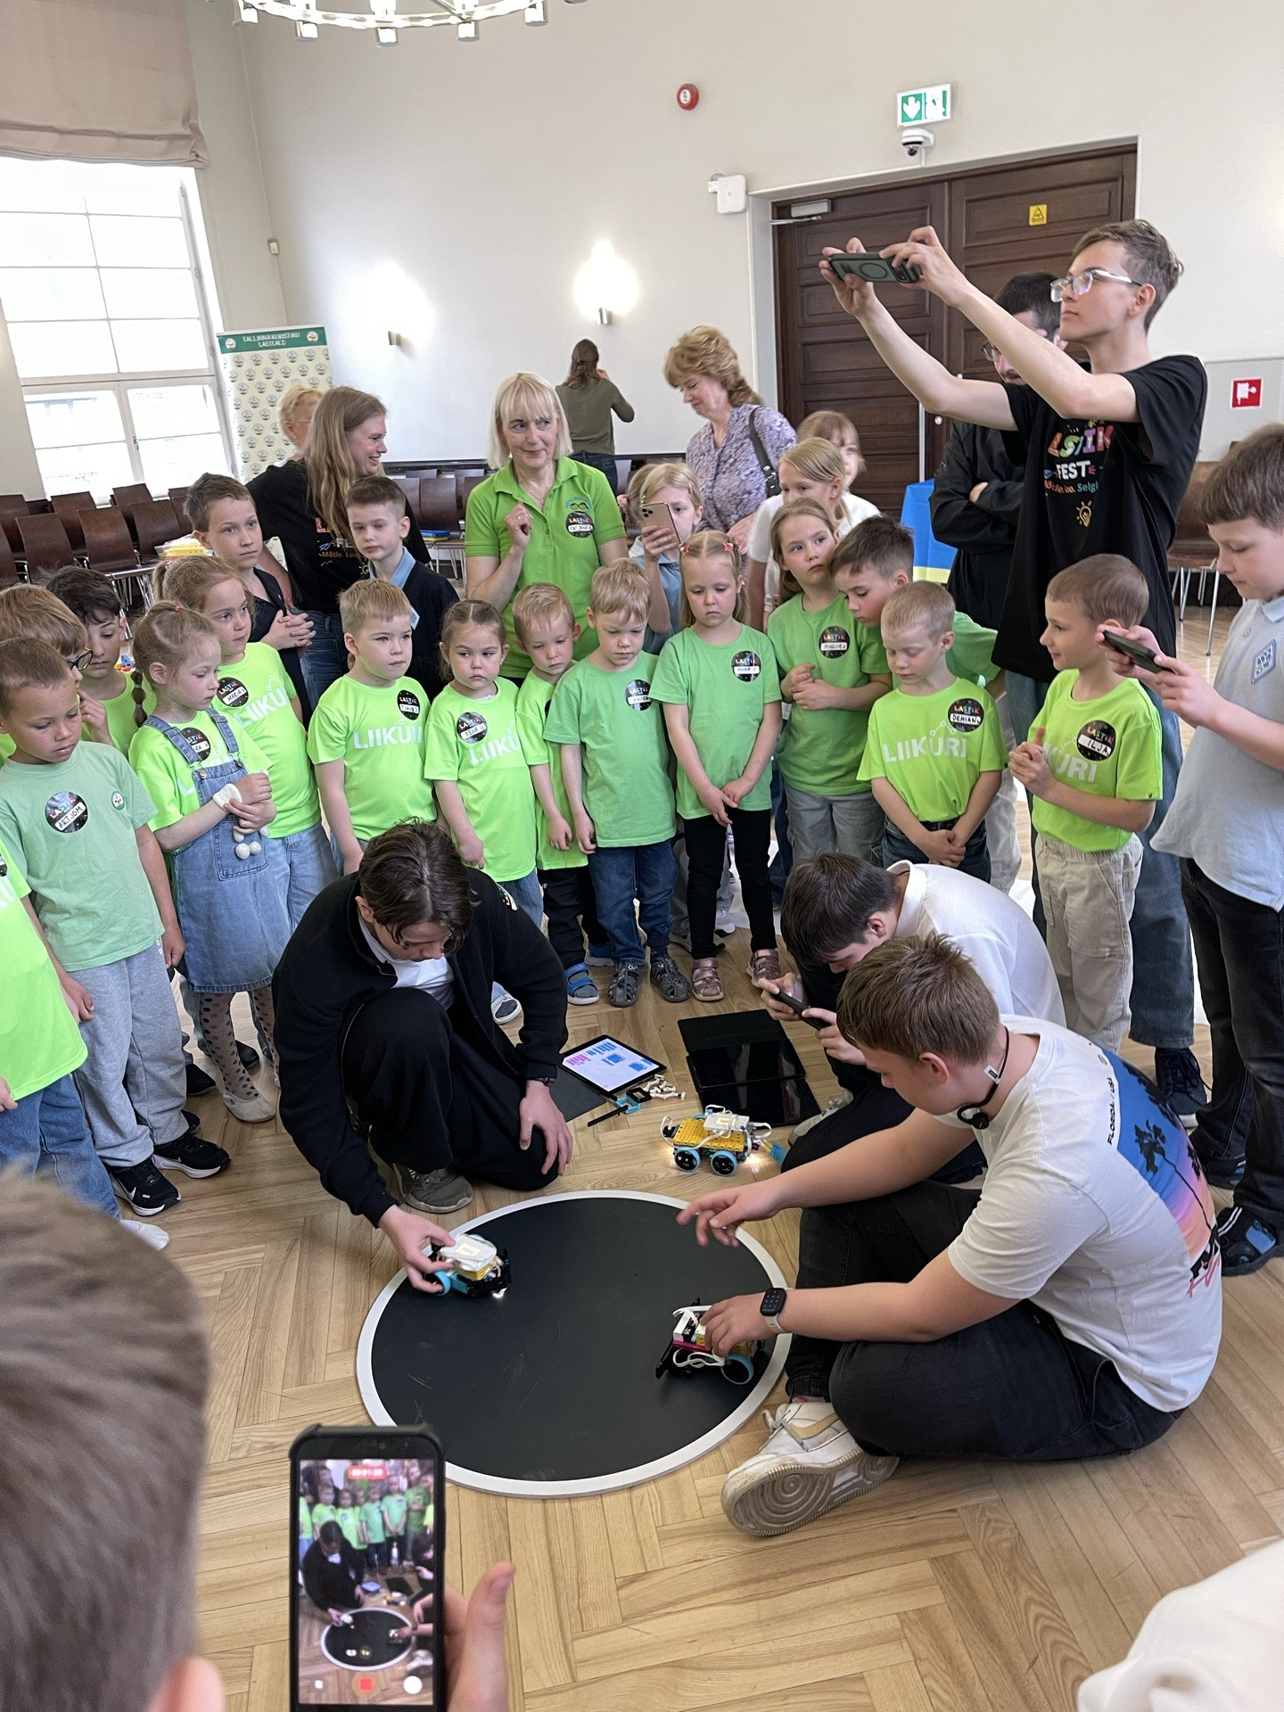
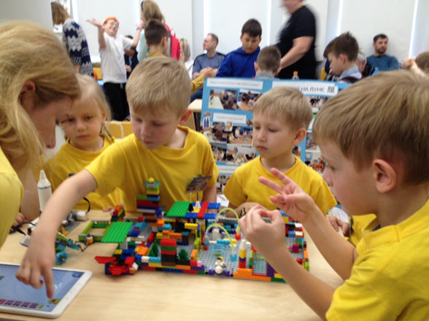
8. STEAM Festivals, Events and Competitions
We share and celebrate STEAM learning through:
STEAM festivals and thematic days;
exhibitions and workshops;
robotics and Gigo competitions;
environmental events;
activities with families;
cooperation with the local community.

Slide 10
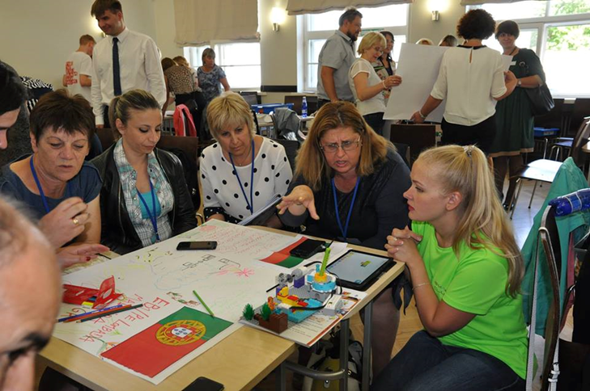
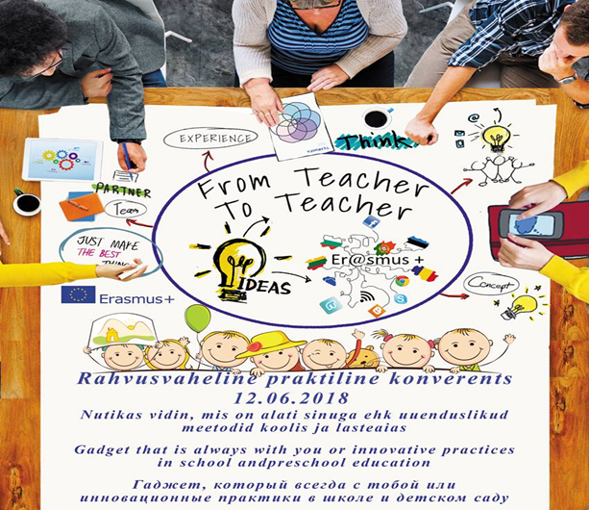
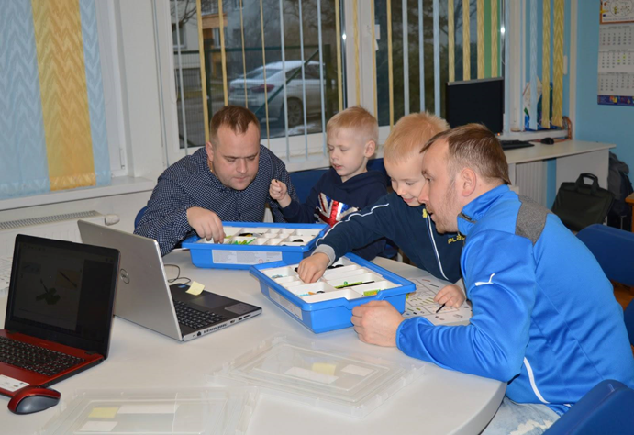
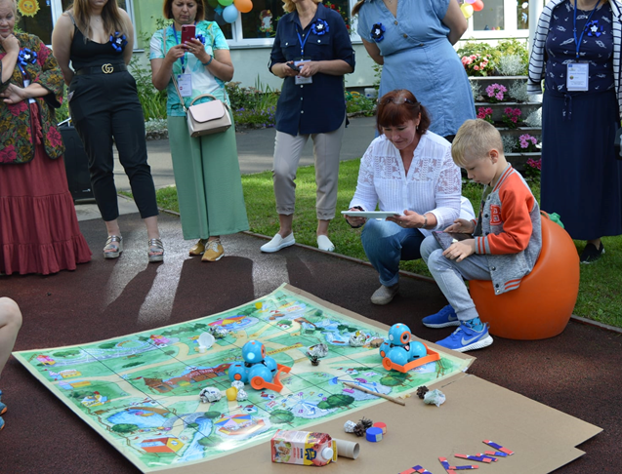
9. International Cooperation
International cooperation helps us grow.
Erasmus+ projects;
Nordplus Junior;
eTwinning cooperation;
exchange of good practices;
Together we inspire children to explore, create and shape the future.

Slide 11
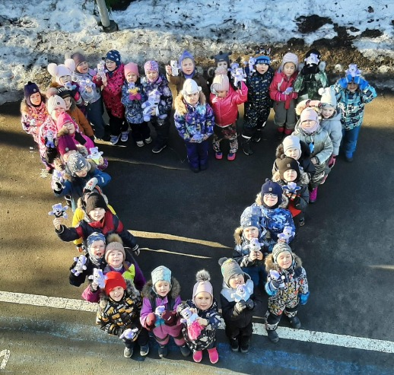
Thank you for your attention!
Welcome to Tallinna Arbu Kindergarten!
arbu@la.tln.edu.ee
http://www.tallinn.ee/arbu/
https://www.facebook.com/TallinnaArbuLasteaed

