Slide 1

DIALOGUE
DIALOGUE FOR INNOVATION
AND BETTER GOVERNANCE
BSB01104
Programme Priority: Competent and Resilient Region
Duration: 15 Months
09/2025-12/2026
The responsibility for the content of this material is that of the author(s). The content of this material does not necessarily represent the official position of the European Union.

Slide 2
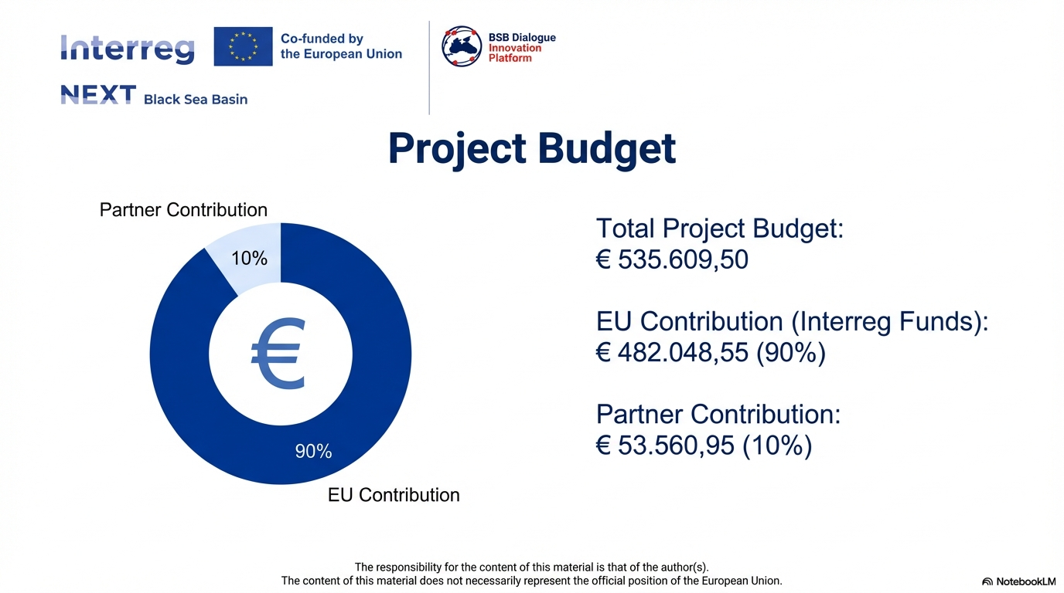

Slide 3







PROJECT PARTNERS
ÇORLU CHAMBER OF COMMERCE AND INDUSTRY(LEAD PARTNER)
INTERNATIONAL MANAGEMENT INSTITUTE (PP2)
GALATI TEHNOPOL ASSOCIATION (PP3)
TRAKYA DEVELOPMENT AGENCY(PP4)
The responsibility for the content of this material is that of the author(s). The content of this material does not necessarily represent the official position of the European Union.

Slide 4
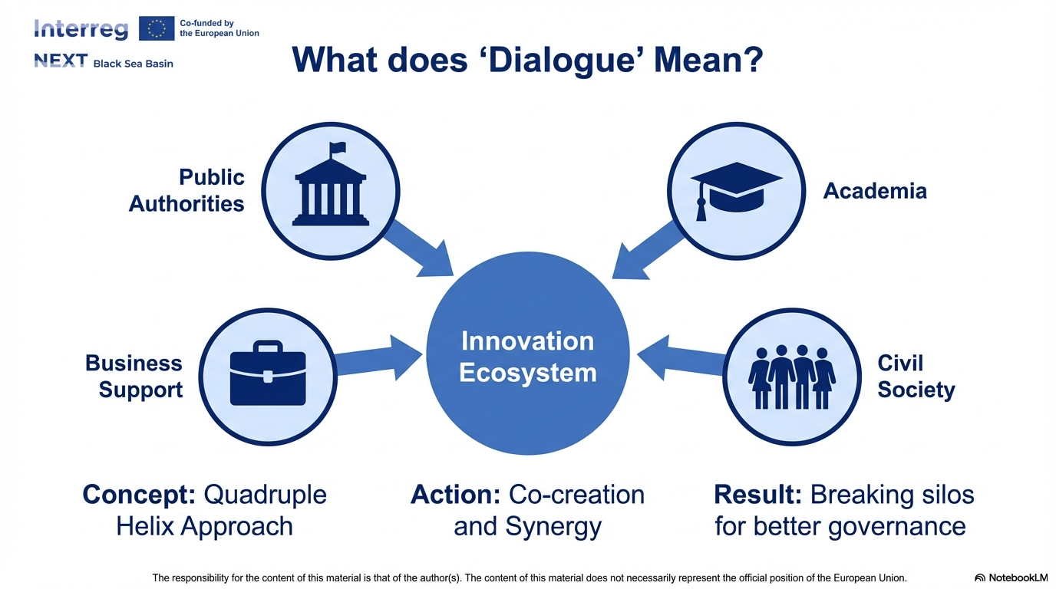

Slide 5
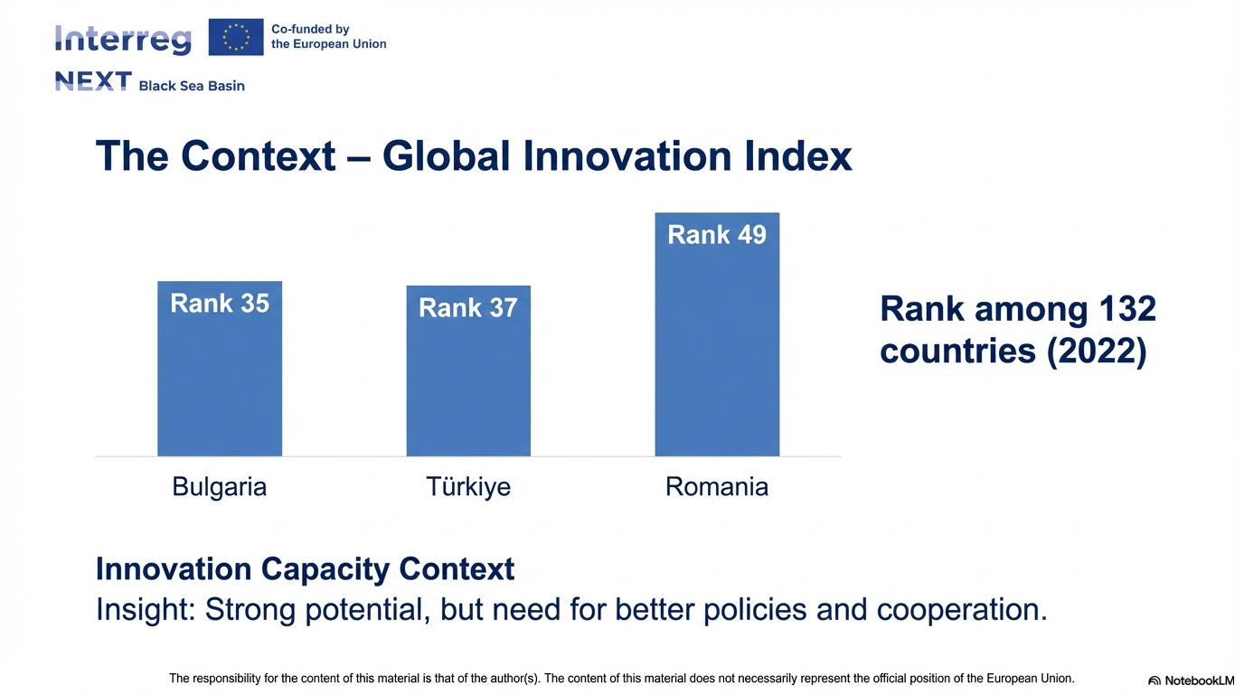

Slide 6
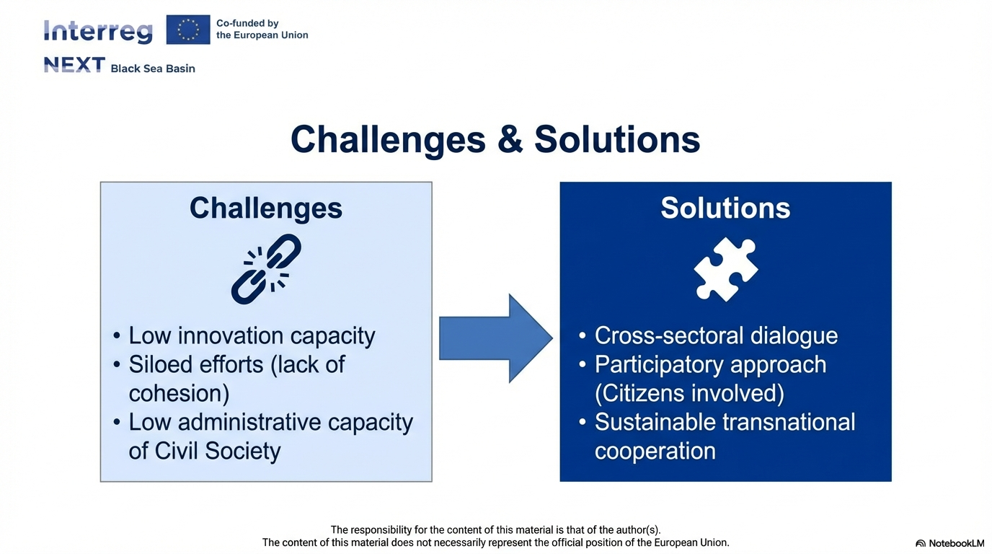

Slide 7
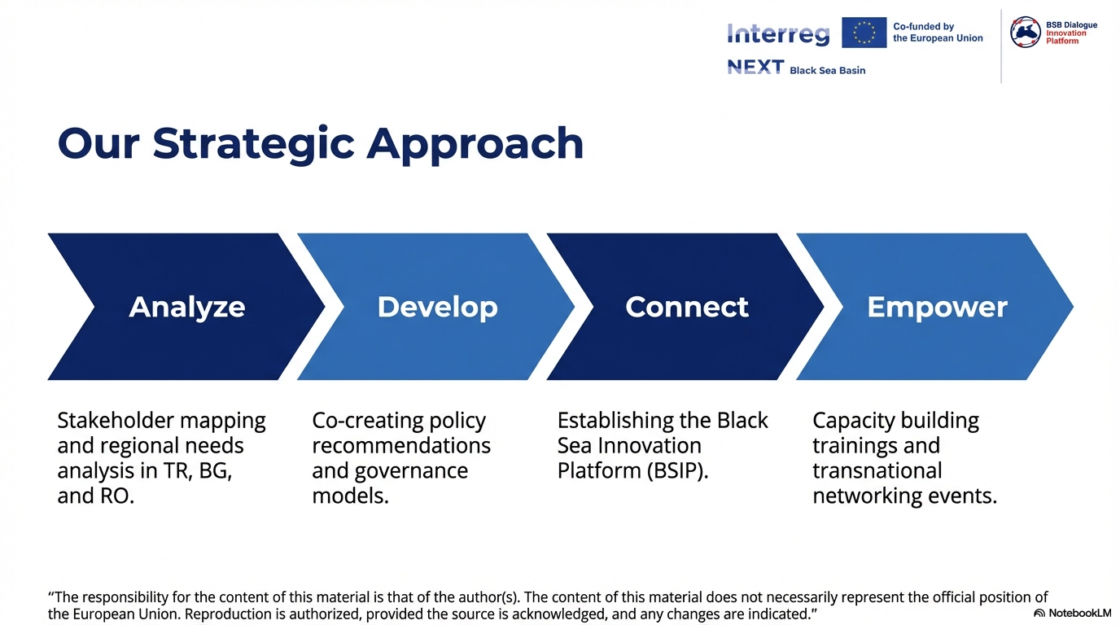

Slide 8
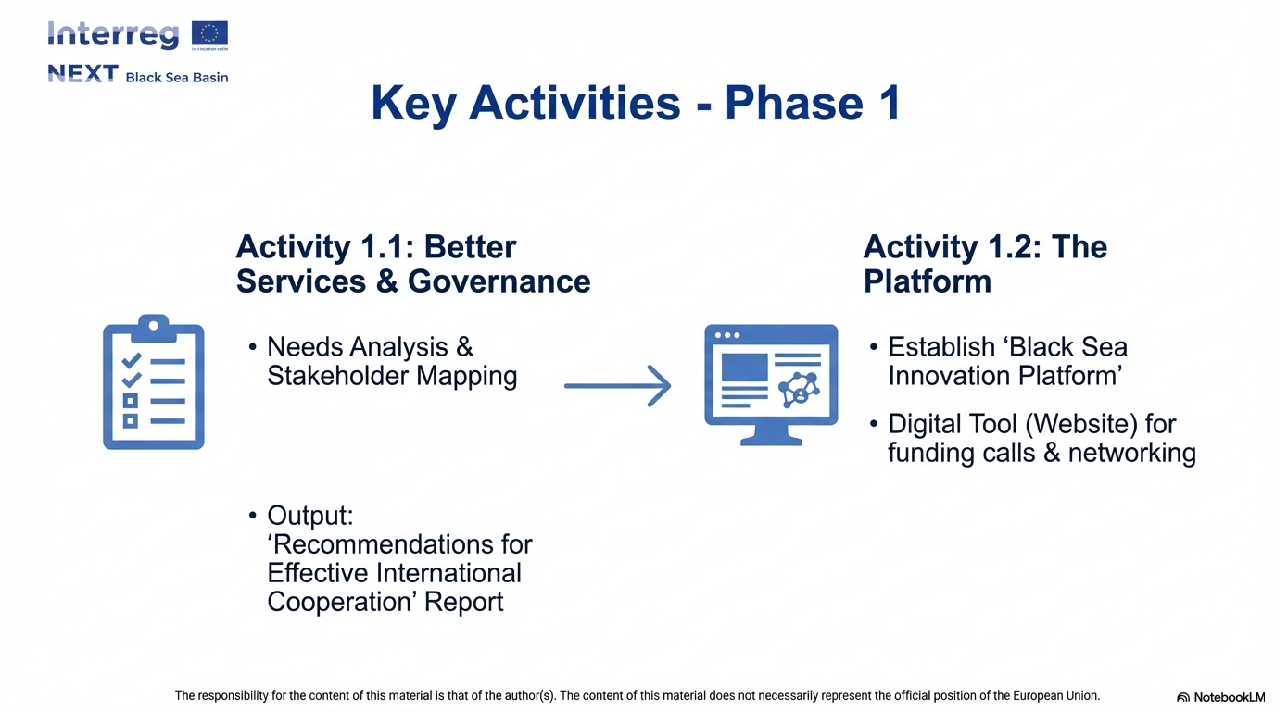

• 4 Local & 1 International
Workshops

Slide 9
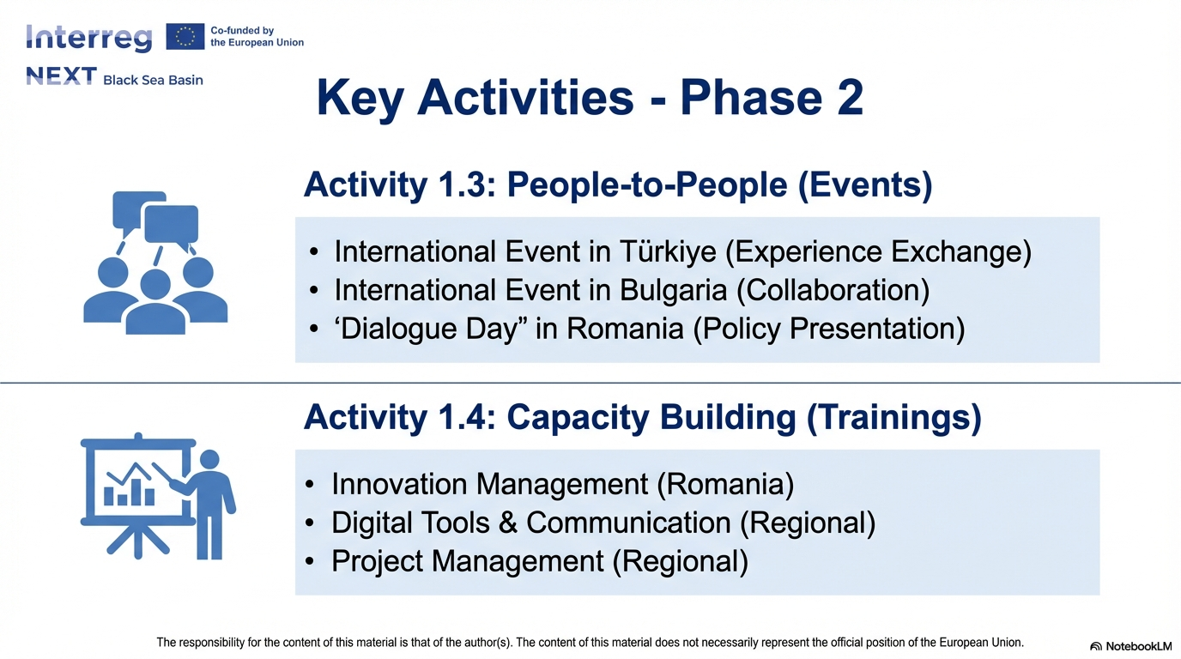

Slide 10
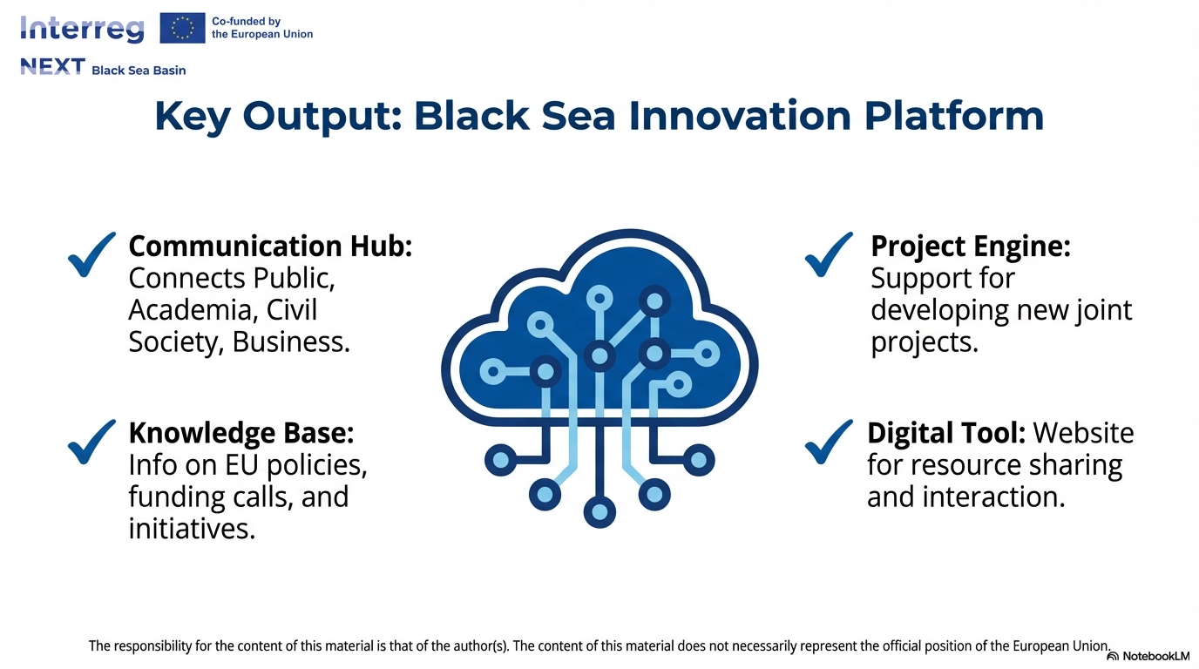

Slide 11
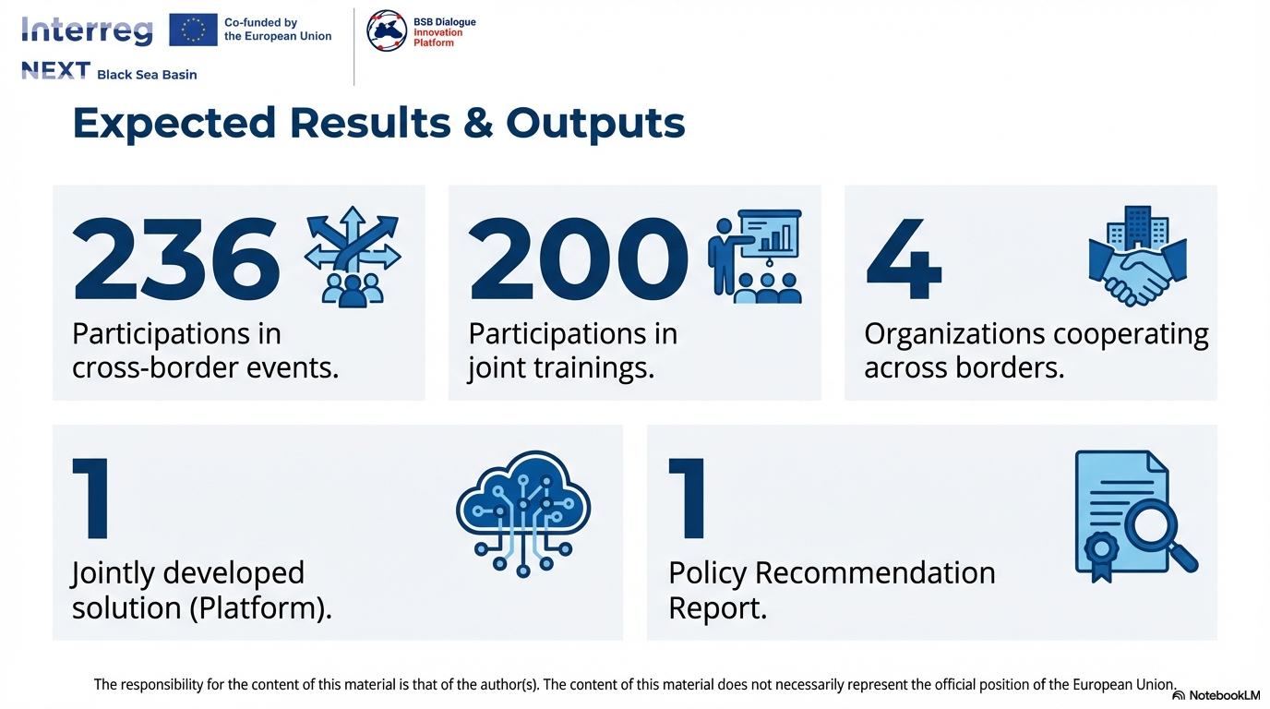

Slide 12
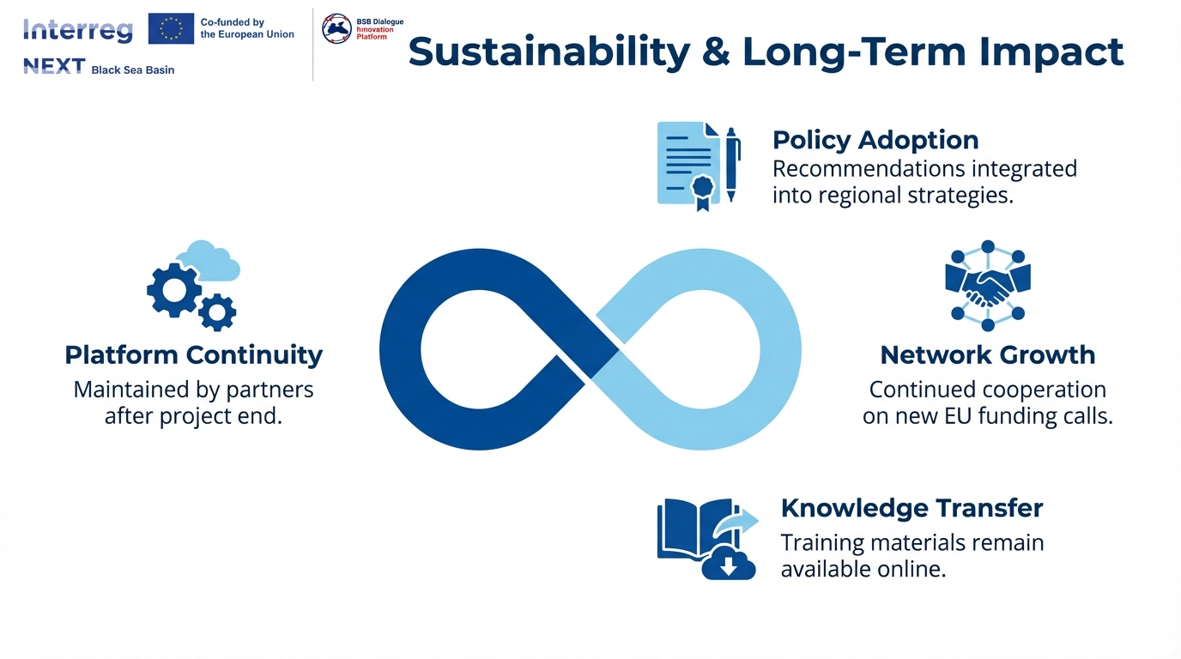
The responsibility for the content of this material is that of the author(s). The content of this material does not necessarily represent the official position of the European Union.

Slide 13
THANK YOU!
FOLLOW US ON SOCIAL MEDIA
@bsbdialogueproject
The responsibility for the content of this material is that of the author(s). The content of this material does not necessarily represent the official position of the European Union.

